Slide 1
Croeso!
Welcome!

Slide 2
Galwad Agored am Gyllid Prosiect Rheolaeth Gynaliadwy o Adnoddau Naturiol (SMNR) Open Call for Sustainable Management of Natural Resources (SMNR) Project Funding

Slide 3
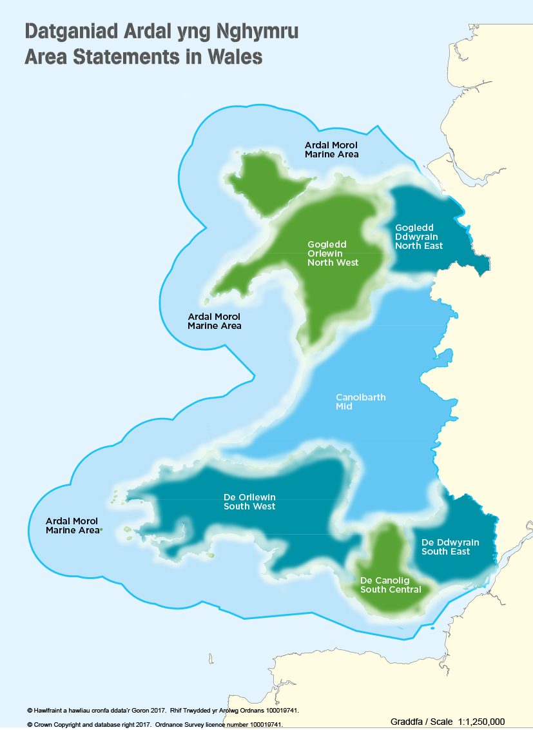

Slide 4
Y broses The Process

Slide 5
Penawdau / Headlines
Tua £3miliwn ar gael ar gyfer y rownd hon
Gwahodd prosiectau 18 mis i ateb yr heriau
Cyfradd ymyrraeth o 50%
Proses 2 gam: Datganiad o Ddiddordeb (DoD) ac yna Cais Llawn
Gwahodd ceisiadau am gymorth heblaw arian, megis mynediad i dir a reolir gan CNC a data
7 ardal Datganiad Ardal
Prosiectau strategol / Gymru gyfan
Circa £3million available for this round
18 month projects invited to answer the challenges
50% intervention rate
2 stage process: Expression of Interest (EoI) and then Full Application
Invite requests for support other than funding, such as access to NRW managed land and data.
7 Area Statement areas
Strategic/All-Wales projects

Slide 6
Galwad am ddatganiadau o ddiddordeb yn agor
Call for expressions of interest opens
14/01/18
Dyddiad cau ar gyfer cyflwyno DoD/ Deadline for submitting EoI
Bydd paneli Cyfoeth Naturiol Cymru yn asesu'r datganiadau o ddiddordeb a dderbynnir, ac yn eu cymedroli wedi hyn
NRW panels to assess expressions of interest received, followed by moderation.
Byddwn yn darparu adborth ar eich DoD
We will provide feedback on your EoI
If your EoI is rejected/ os caiff eich DoD ei wrthod
Byddwch yn cael gwahoddiad I wneud cais llawn
You will be invited to make a full application/.
15/02/18
Cyhoeddi canlyniadu’r DoD Results of EoI notified
If your EoI is selected/ os caiff eich DoD ei ddewis

Slide 7
Y ffurflen / The Form

Slide 8
Y Ffurflen Datganiad o Ddiddordeb (DoD) The Expression of Interest (EoI) Form
Ar gael ar wefan CNC
Mae’r arweiniad yn cynnwys llawer mwy o fanylder a’r holl heriau Ardal
Dyddiad cau : hanner nos Dydd Sul 14 Ionawr 2018
Rydym yn croesawu cyflwyniadau yn Gymraeg ac yn Saesneg.
Cyfyngiad nifer y geiriau ar y blychau
Dim ond mapiau y gellir eu cynnwys fel gwybodaeth atodol
Available on NRW website
Guidance includes much more detail and all the Area challenges
Deadline midnight Sunday 14th January 2018
Welcome to submit in Welsh or English language
Maximum word count on boxes
Only maps to be included as supplementary information

Slide 9
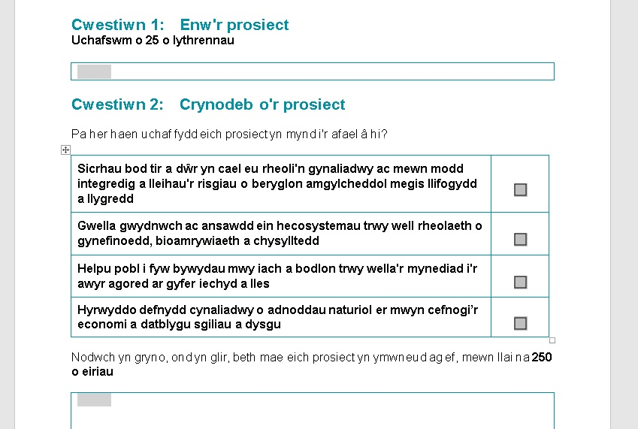

Slide 10
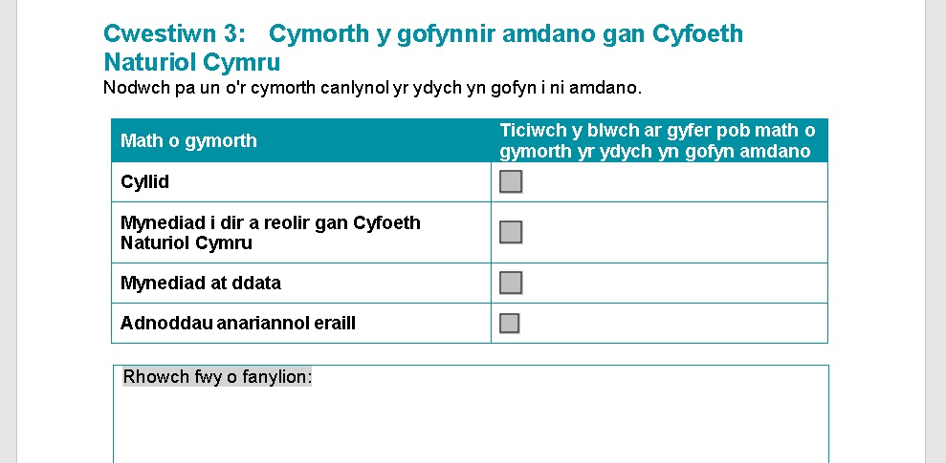

Slide 11
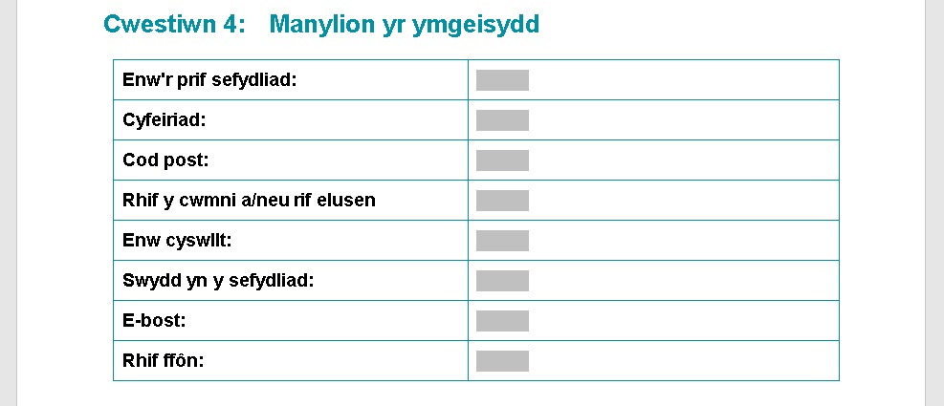

Slide 12
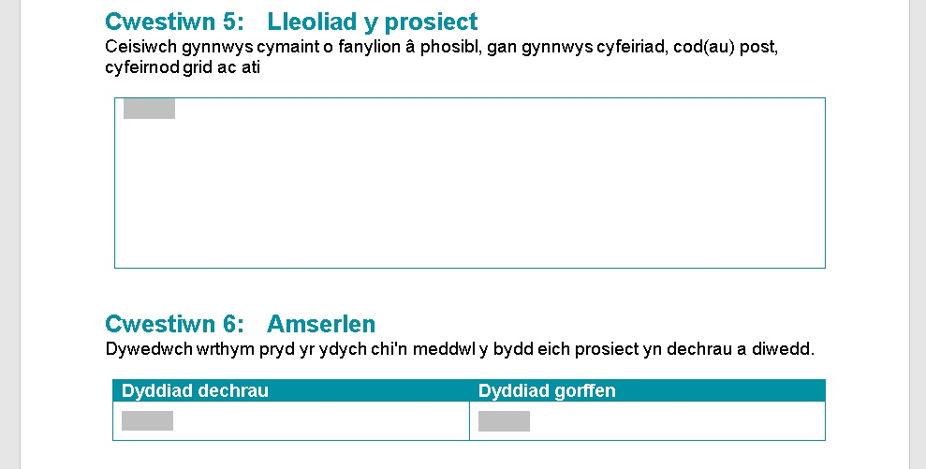

Slide 14
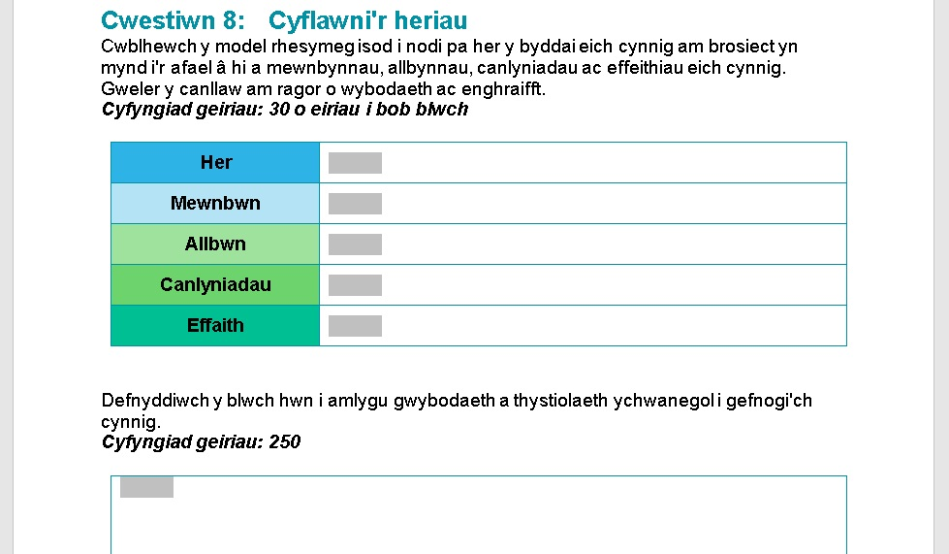

Slide 16
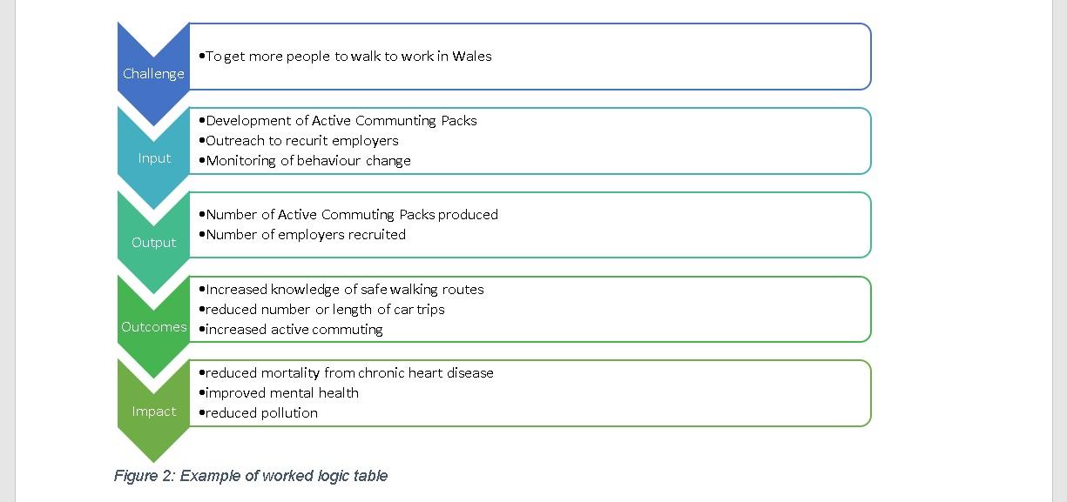

Slide 18
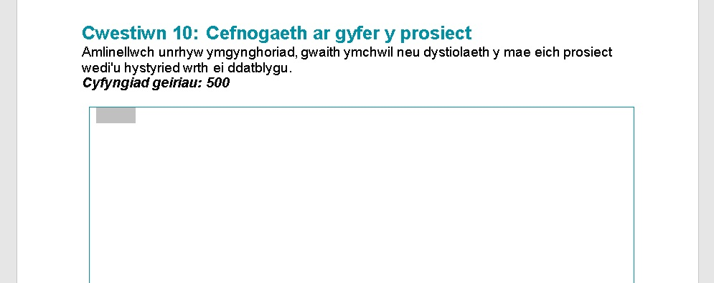

Slide 19
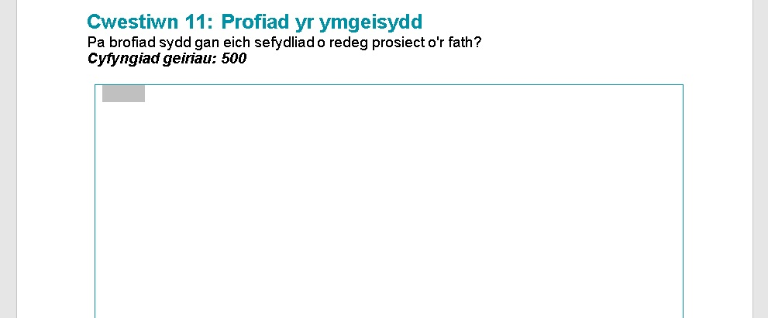

Slide 20
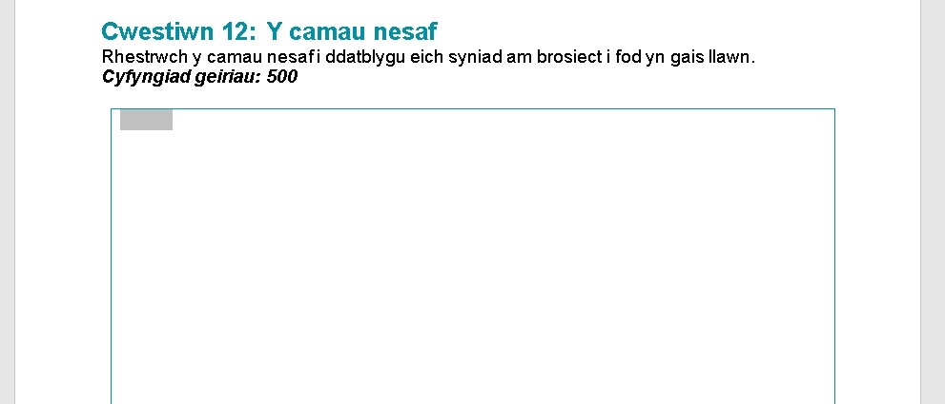

Slide 21
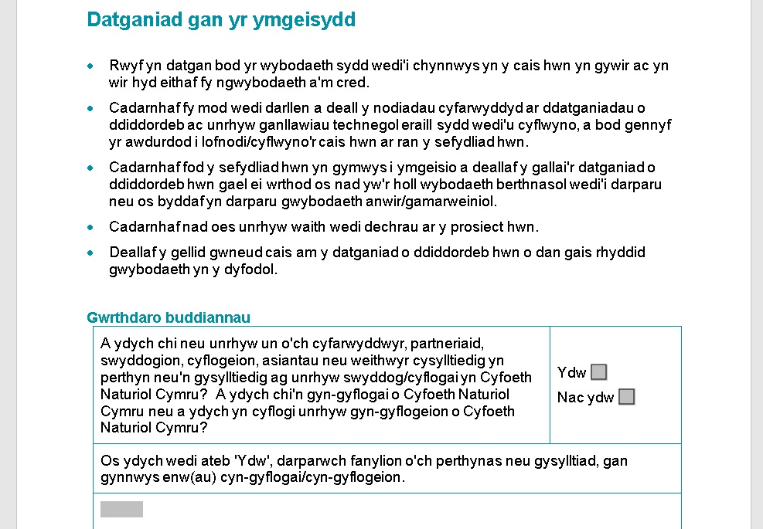

Slide 23
Non-scored questions/ Cwestiynau heb eu sgorio
Project Name/ Enw’r prosiect | Info only Er gwybodaeth yn unig
Project Summary/ Crynodeb o'r prosiect | Info only Er gwybodaeth yn unig
Applicant details/ Manylion yr ymgeisydd | Must be a registered not-for-profit Rhaid bod yn sefydliad dielw cofrestredig
Project location/ Lleoliad y prosiect | Impact must be predominantly in Wales/ Rhaid i’r effaith fod yng Nghymru yn bennaf
Timescale/ Amserlen | Project must be completed by December 2019/ Rhaid cwblhau'r prosiect erbyn diwedd mis Rhagfyr 2019
Financial Information/ Gwybodaeth ariannol | NRW maximum intervention rate 50% Cyfradd ymyrraeth uchaf CNC 50%
Other support/ Cymorth arall | Info only Er gwybodaeth yn unig

Slide 24
Scored questions/Cwestiynau sy’n sgorio
 | Range | Weighting
Meeting the Challenges/ Cyflawni'r heriau | 1-5 | x3
Embedding of Sustainable Management of Natural Resources Principles/ Ymwreiddio egwyddorion rheoli adnoddau naturiol yn gynaliadwy | 1-5 | x3
Support for the proposal/ Cefnogaeth ar gyfer y cynnig | 1-5 | X2
Applicant experience/ Profiad yr ymgeisydd | 1-5 | x1
Next steps/ Y camau nesaf | 1-5 | X2

Slide 25
16/02/18 – 15/04/18
Datblygu’r cais llawn / Development of full application
16/04/18
Dyddiad cau cyflwyno’r cais llawn/ Deadline for submitting full application
Os nad ydych yn llwyddiannus/ If you are not successful
Byddwn yn rhoi adborth ar eich cais llawn / We will provide feedback on your full application
Panel CNC yn cyfarfod i edrych ar geisiadau llawn a dderbyniwyd. NRW panel meets to look at full applications received.
Cymedroli a Chymeradwyo
Moderation & Approval
Os ydych yn llwyddiannus / If you are successful
01/06/18
Gwnaed Cynigion Ffurfiol (os bydd yr holl ddogfennau wedi’u cwblhau) / Formal Offers made (subject to all documentation being complete)

Slide 26
Cais llawn / Full Application
Bydd yr wybodaeth ychwanegol y bydd ei hangen yn ystod yr ail gyfnod yn cynnwys:
Dadansoddiad ariannol llawn, cadarnhad o'r cyllid cyfatebol, mewn arian neu drwy ddull arall, rhagolygon llif arian ac ati
Cadarnhad bod pob caniatâd, trwydded a chydsyniad wedi'i roi, lle bo angen
Cydymffurfiaeth â gofynion rheoleiddio a pholisi Cyfoeth Naturiol Cymru, gan gynnwys y Polisi Amgylcheddol, y polisi Cydraddoldeb ac Amrywiaeth, Safonau'r Iaith Gymraeg, diogelu data, a deddfwriaeth iechyd a diogelwch
Additional information needed at this stage will include:
Full financial breakdown, confirmation of match funding, in-kind contribution, cash flow forecasts etc
All permissions, licenses and consents have been granted, where required
Compliance with regulatory and NRW policy requirements including, but not limited to, Equality & Diversity, Environmental Policy, data protection, Health & Safety.

Slide 27
More help?/ Mwy o help?
General queries and form submission:
FundingApplication@cyfoethnaturiolcymru.gov.uk
Finance queries:
Grants.enquiries@cyfoethnaturiolcymru.gov.uk
Area | Contact
Strategic / All-Wales Cymru gyfan | FundingApplication@cyfoethnaturiolcymru.gov.uk
Marine/ Morol | Kathryn Hughes Kathryn.hughes@cyfoethnaturiolcymru.gov.uk
Mid Wales/ Canolbarth Cymru | Linda Ashton linda.ashton@cyfoethnaturiolcymru.gov.uk
North East Wales/ Gogledd-ddwyrain Cymru | Paul Mitchell paul.mitchell@cyfoethnaturiolcymru.gov.uk
North West Wales/ Gogledd-orllewin Cymru | Alun Price Alun.Price@cyfoethnaturiolcymru.gov.uk
South Central Wales/ Canol De Cymru | Miki Miyata-Lee miki.miyata-lee@cyfoethnaturiolcymru.gov.uk Chris Heaps chris.heaps@cyfoethnaturiolcymru.gov.uk
South East Wales/ De-ddwyrain Cymru | Sarah Tindal sarah.tindal@cyfoethnaturiolcymru.gov.uk Sarah Coakham sarah.coakham@cyfoethnaturiolcymru.gov.uk
South West Wales/ De-orllewin Cymru | Aled Davies aled.davies@cyfoethnaturiolcymru.gov.uk Glyn Jones glyn.jones@cyfoethnaturiolcymru.gov.uk

Slide 28
Finance hints and tips Awgrymiadau a chymorth cyllid

Slide 29
When should I consider costs?
As soon as possible – at the application stage
The earlier that costs are identified the more accurate they will be.
Start with a ‘shopping list’ approach
Read the Financial and fund Guidelines
Think about eligibility and procurement rules
Eligible costs will need to be evidenced in future claims
Pryd y dylwn i ystyried costau?
Cyn gynted a phosib – ar adeg cwblhau y cais
Y cynhara y caiff y costau eu hadnabod – y mwyaf cywir y byddant
Dechreuwch gydag agwedd ‘rhestr siopa’
Darllenwch y canllawiau ariannol a chyllid
Meddyliwch am reolau cymhwyster a chaffael
Bydd angen tystiolaeth o gostau cymwys mewn hawliadau yn y dyfodol
Notes:
.

Slide 30
Partner or Supplier?
We all have to comply with procurement rules, you must be able to demonstrate open competition and transparency for staff, services or goods.
To be a partner within the project you must contribute towards the cost of the project, any contribution would be calculated at cost. You must follow procurement rules to obtain goods or services of staff
A supplier is paid for their time or goods ( buying a service) and must be selected using open competition. Staff must be selected under equal opportunities.
Partner neu gyflenwr
Mae’n rhaid i ni gyd gydymffurfio â rheolau caffael, mae'n rhaid i chi allu dangos cystadleuaeth agored a thryloywder ar gyfer gwasanaethau staff eu nwyddau.
I fod yn bartner of fewn y prosiect mae'n rhaid i chi gyfrannu tuag at gost y prosiect, byddai unrhyw gyfraniad yn cael ei gyfrifo am bris ‘cost’. Rhaid i chi ddilyn rheolau caffael i gael nwyddau neu wasanaethau staff.
Mae cyflenwr yn cael ei dalu am eu hamser neu nwyddau (prynu gwasanaeth) a rhaid ei ddewis gan ddefnyddio cystadleuaeh agored, rhaid dewis staff o dan gyfle cyfartal.

Slide 31
Ineligible costs (please see a full list in the EOI guidance)
Costs which have taken place before the agreed project start date
The funding of core activities of an organisation
On-going management or maintenance works.
Work outside Wales
Funding commercial or profit making organisations
Maintenance costs on Public Rights of Way
Where funding for a project from exchequer monies exceeds 50% or State Aid.
Schemes where work has been completed or is underway.
Survey and data gathering in isolation.
Development of websites
Consultancy
Work within NRW’s statutory remit
Costau anghymwys(gweler rhestr llaw yn y canllawiau MoDd)
Costau sydd wedi digwydd cyn dyddiad cychwyn y prosiect y cytunwyd arno
Ariannu gweithgareddau craidd y sefydliad.
Unrhyw waith cynnal a chadw sydd yn cael ei wneud eisioes
Gwaith y tu allan i Gymru
Ariannu sefydliadau mashnachol neu elw masnachol
Costau cynnal a chadw ar Hawliau Tramwy Cyhoeddus
Lle mae ariannu prosiect o arian Y Trysorlys yn fwy na 50% neu Gymorth Gwladwriaethol
Cynlluniau lle mae gwaith wedi’I gwblhau neu sydd ar y gweill
Arolwg a chasglu data ar ben ei hun
Datblygu gwefan
Ymgynghoriaeth
Gweithio o fewn cylch gwaith statudol CNC

Slide 32
Building Project costs/Adeiladu costau prosiect
Budget Headings/Penawdau cyllideb
Personnel/Staff time Amser personél / staff
Travel and subsistence Teithio a chynhaliaeth
External Assistance Cymorth allanol
Durable goods Nwyddau parhaol
Consumables Nwyddau traul
Other costs Costau eraill
Volunteer Gwirfoddolwyr

Slide 33
Building staff costs/Adeiladu costau staff
Personnel/Personel
Build in all staff costs for posts which will be directly involved in the project
Must only include costs which would only occur as a direct result of project activity
All staff whether full time or part time MUST be officially seconded to the project and appointed through open competition. (contract letter)
At application stage you will need to specify how many days each person will spend on the project.
Staff costs are calculated as:
Adeiladu costau staff a swyddi a fydd yn ywneud a’r prosiect yn uniongyrchol.
Dim ond costau a fyddai yn digwydd yn uniongyrchol o ganlyiad i weithgaredd y prosiect ddylai gael eu cynnwys.
Rhaid i holl staff, llawn amser neu ran-amser, gael eu eilio’n sywddogol i’r prosiect a’u penodi trwy gystadlaeath agored (llythyr contract)
Ar adeg y cais, bydd angen I chwi nodi faint o ddyddiau y bydd pob person yn ei wario ar y prosiect.
Cyfrifir costau staff fel:

Slide 34
Staff daily rates
Post: | £
Basic/Syml | £20,000
Pension/Pensiwn | £4,000
NI/YD | £3,500
Total/Cyfanswm | £27,500
Divided by number of days/Rhannu gan nifer y dyddiau | 220
Daily rate | £125
Contracted days less annual and statutory leave- we use 220 for a FTE to ensure consistency
Dyddiau dan gontract -absenoldeb blynyddol a statudol wedi ei dynny I ffwrdd- rydym yn defnyddio 220 ar gyfer ACLlA i sicrhau cysondeb

Slide 35
Overheads/Gorbenion
Option 1
Full Project Cost Recovery
Project overheads would need to be identified separately and include a methodology showing the calculations and how they have been apportioned to the project.
The costs will be subject to scrutiny and approval, claims will take longer to process as they will need to be fully evidenced.
Opsiwn 1
Adborth amlwg o orbenion
Byddai angen dynodi'r gorbenion ar wahân, a chynnwys methodoleg yn dangos y cyfrifiadau a sut y cawsant eu dosrannu i'r prosiect.
Bydd y costau'n destun sgriwtini a chymeradwyaeth, bydd hawliadau yn cymeryd mwy o amser i'w prosesu gan y bydd angen iddynt gael tystiolaeth lawn
Includes office costs, gas, electric, rent, telephone, support functions (finance)

Slide 36
Overheads/Gorbenion
Option 2
7% Flat rate
Applicants can add on 7% flat rate of all costs excluding ‘durable goods’ and ‘volunteers’.
This does not have to be evidenced, is easier to calculate, and speedier processing, for both ourselves and the organisation submitting the claim.
Opsiwn 2
7% Cyfradd unffurf
Gall ymgeiswyr ychwanegu cyfradd unffurf o 7% o’r holl gostau ac eithro nwyddau parhaol a gwirfoddolwyr
Nid oes angen tystiolaeth o hyn, mae’n haws eu gyfrifo ar gyfer y ddau sefydliad a byddai prosesu yn gyflymach gennym ni a’r sefydliad sy’n cyflwyno’

Slide 37
Match funding/Arian Cyfatebol
Your contribution must be ‘clean’ funds – no double funding!
All parties are expected to make a contribution either in kind or cash contribution
Staff time as match
If using staff time as match then you must be able to prove that the work would not have taken place if the project did not exist – Additionality
Lead Partner must make a 10% cash contribution
Match funding IS audited, treat as all other expenditure!
Rhaid i'ch cyfraniad fod yn arian 'glân' - dim arian wedi ei ‘ddyblu’!
Disgwylir i bob ‘partner’ wneud cyfraniad naill ai mewn ‘nwyddau’ neu arian parod
Amser staff fel cyfateb
Os yw amser staff yn cael ei ddefnyddio fel amser cyfatebol, yna mae’n rhaid i chi allu profi na fyddai’r gwaith wedi digwydd pe na bai’r prosiect yn bodoli - Ychwanegolrwydd – rhaid bod nodyn ar gontract y gweithiwr
Rhaid i'r Partner Arweiniol wneud cyfraniad arian o 10%
Mae arian cyfatebol YN cael ei archwilio, rhaid ei drin fel yr holl wariant arall!

Slide 38
Claims evidence for volunteers/Tystiolaeth gwirfoddolwyr ar gyfer hawliadau
Timesheets – make sure they are completed
Ensure that volunteers are completing timesheets
All timesheets must mention the project code/name
Signed by supervisor and volunteer.
Travel
- NRW rates must not be exceeded
- Rail travel should be booked in advance to ensure the cheapest travel
- NRW will not allow any flights to be costed into the application/claim
Taflenni amser – sicrhewch eu bod wedi eu cwblhau
- Sicrhewch fod gwirfoddolwyr yn cwblhau taflenni amser
- Dylai pob taflen amser nodi côd/enw’r prosiect
- Wedi ei arwyddo gan y goruchwyliwr a’r gwirfoddolwr
Teithio
- Ni ddylid mynd y tu hwn i gyfraddau CNC
- Dylid archebu teithiau ar y rheilffyrdd o flaen llaw I sicrhau’r prisiau rhataf
- Ni fydd CNC yn caniatau unrhyw gôst hedfan yn y ffurflen gais/hawlio
Notes:
.

Slide 39
Volunteers/Gwirfoddolwyr
The rate for volunteers are as follows/Mae'r gyfradd ar gyfer gwirfoddolwyr fel a ganlyn: -
Unskilled/Admin £7.83 per hr (£62.64 per 8hr day)
(from April 18)
Supervisor/ £12.50 per hr (£100 per 8hr day)
(Technical skills)
Professional £37.50 per hr (£300 per 8hr day)
(legal scrutiny)
Disgwyliedig / Gweinyddol £ 7.83 y bore (£ 62.64 y dydd 8 awr - o fis Ebrill 18)
Goruchwyliwr / £ 12.50 yr awr (£ 100 y dydd 8 awr) (Sgiliau technegol)
Proffesiynol £ 37.50 yr awr (£ 300 y dydd 8 awr) (craffu cyfreithiol)

Slide 40
Milage rates/Cyfraddau milltiroedd
Cars and vans 45p per mile
Passenger 5p per mile
Towing rate 13.5p per mile
Motor cycles 24p per mile
Bicycles 20p per mile
Ceir a faniau 45c y filltir Teithwyr 5c y filltir Cyfradd tynnu 13.5c y filltir Beiciau modur 24c y filltir Beiciau 20c y filltir

Slide 41
Claims/Hawliadau
Ensure that you have the controls in place to ensure that invoices are not paid without proper checks
Ensure that invoices and receipts are made out to your organisation
Keep original invoices with the project, filed sequentially and referenced in case needed for audit
Costs are only eligible if they have been incurred during the life of the project, relevant to the project application and must have been paid before you submit the claim.
Transaction list of actual spend- summary of invoices
Sicrhewch fod gennych y rheolaethau ar waith i sicrhau nad yw anfonebau yn cael eu talu heb wiriadau priodol Sicrhau bod anfonebau a derbynebau yn cael eu gwneud i'ch sefydliad Cadwch anfonebau gwreiddiol gyda'r prosiect, a ffeiliwyd yn gyfansoddiadol a chyfeirir ato yn yr achos sy'n ofynnol i'w harchwilio Mae'r costau yn gymwys yn unig os cawsant eu codi yn ystod oes y prosiect, sy'n berthnasol i gais y prosiect a rhaid eu talu cyn i chi gyflwyno'r cais. Rhestr trafodion o wariant gwirioneddol - crynodeb o anfonebau

Slide 42
General Principles/Egwyddorion Cyffredinol
Lead partner must make minimum 10% cash contribution towards the project costs.
Ensure you have sufficient funds, match funders and that your budget is as accurate as possible
The total cost of your funders must match the total cost of your project
Funding cannot be offered retrospectively or paid in advance
Rhaid i'r partner arweiniol wneud cyfraniad ariannol o leiaf 10% tuag at gostau'r prosiect. Sicrhewch fod gennych ddigon o arian, arianwyr cyfatebol a bod eich cyllideb mor gywir â phosib Rhaid i gyfanswm cost eich cyllidwyr gyd-fynd â chyfanswm cost eich prosiect Ni ellir cynnig cyllid yn ôl-weithredol na thalu ymlaen llaw

Slide 43
Questions/Cwestiynau
Thank you for your time/Diolch am eich amser
Your local Partnerships Officers are there to support you in the management of partnership funding so please contact them.
Mae eich Swyddogion Partneriaethau lleol yno i'ch cefnogi chi wrth reoli arian partneriaeth felly cysylltwch â nhw.
For financial support with any future NRW funding agreement or claim please contact the Finance Partnership & Grants Team.
I gael cymorth ariannol gydag unrhyw gytundeb neu hawliad cyllid NRW yn y dyfodol, cysylltwch â'r Tîm Partneriaeth Cyllid a Grantiau.
Grants.enquiries@cyfoethnaturiolcymru.gov.uk
Shirley Hughes
Hayley MacDonald Jones
Carolyn Williams

Slide 44
Diolch
Thank you

Slide 45
More help?/ Mwy o help?
General queries and form submission:
FundingApplication@cyfoethnaturiolcymru.gov.uk
Finance queries:
Grants.enquiries@cyfoethnaturiolcymru.gov.uk
Area | Contact
Strategic / All-Wales Cymru gyfan | FundingApplication@cyfoethnaturiolcymru.gov.uk
Marine/ Morol | Kathryn Hughes Kathryn.hughes@cyfoethnaturiolcymru.gov.uk
Mid Wales/ Canolbarth Cymru | Linda Ashton linda.ashton@cyfoethnaturiolcymru.gov.uk
North East Wales/ Gogledd-ddwyrain Cymru | Paul Mitchell paul.mitchell@cyfoethnaturiolcymru.gov.uk
North West Wales/ Gogledd-orllewin Cymru | Alun Price Alun.Price@cyfoethnaturiolcymru.gov.uk
South Central Wales/ Canol De Cymru | Miki Miyata-Lee miki.miyata-lee@cyfoethnaturiolcymru.gov.uk Chris Heaps chris.heaps@cyfoethnaturiolcymru.gov.uk
South East Wales/ De-ddwyrain Cymru | Sarah Tindal sarah.tindal@cyfoethnaturiolcymru.gov.uk Sarah Coakham sarah.coakham@cyfoethnaturiolcymru.gov.uk
South West Wales/ De-orllewin Cymru | Aled Davies aled.davies@cyfoethnaturiolcymru.gov.uk Glyn Jones glyn.jones@cyfoethnaturiolcymru.gov.uk

