Slide 1
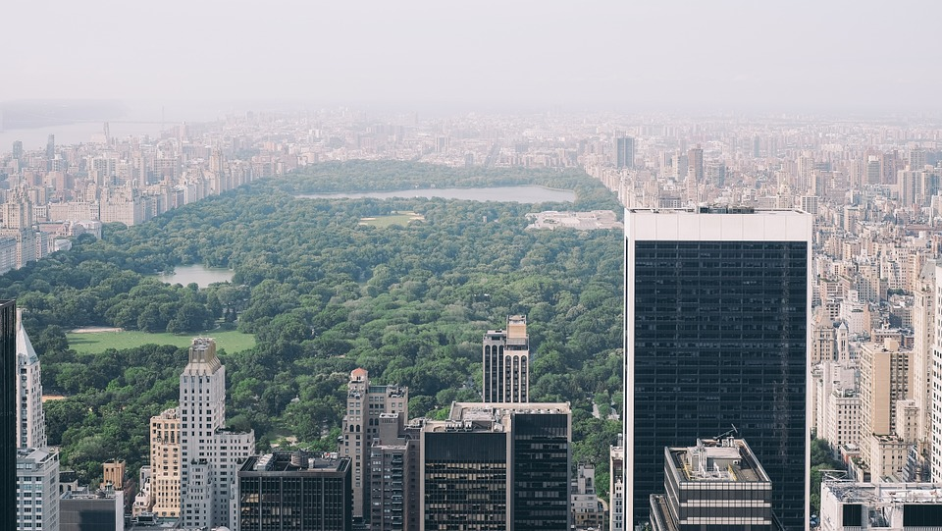
Green Infrastructure in New York City
Louise Ellis
louise.ellis@arup.com
Notes:
Good morning, I’m Louise and I am a senior water engineer with Arup based in Wales and the South-west.
Previously worked for Arup in the New York Office working on several green infrastructure projects in the city.

Slide 2
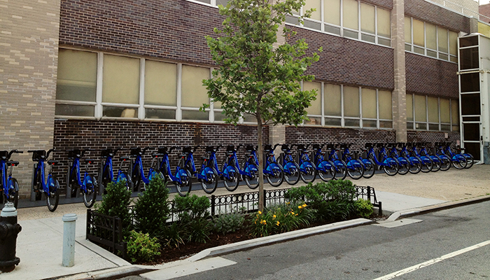
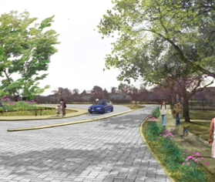
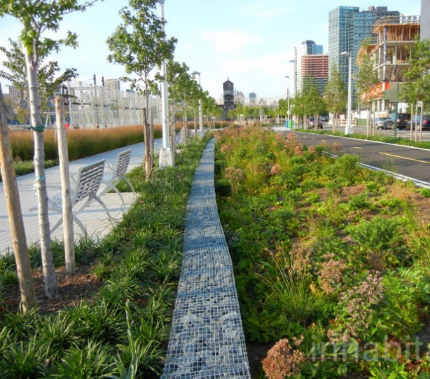
Contents
NYC Department of Environmental Protection Green Infrastructure Program
NY Rising Green Infrastructure Plan
Hunter’s Point South Waterfront Park
Notes:
Today I’m going to talk about three NY projects:
NYC Department of Environmental Green Infrastructure Program, which is the roll out of green infrastructure in public streets across large areas of the city.
NY Rising Green Infrastructure Plan, which looks at planning for green infrastructure and incorporating it into streets as well as schools and public buildings
Hunter’s Point South Park, which is an example of the design and construction of GI for a public park.

Slide 3
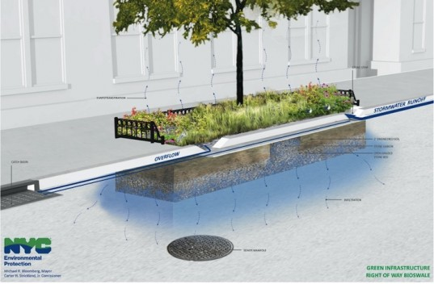
NYC DEP Green Infrastructure Program
Notes:
I’ll begin by talking about the NYC DEP GI Program. This program aims to combat CSO spills by infiltrating the first 1” of rainfall from 10% of the city’s impervious surfaces.

Slide 4
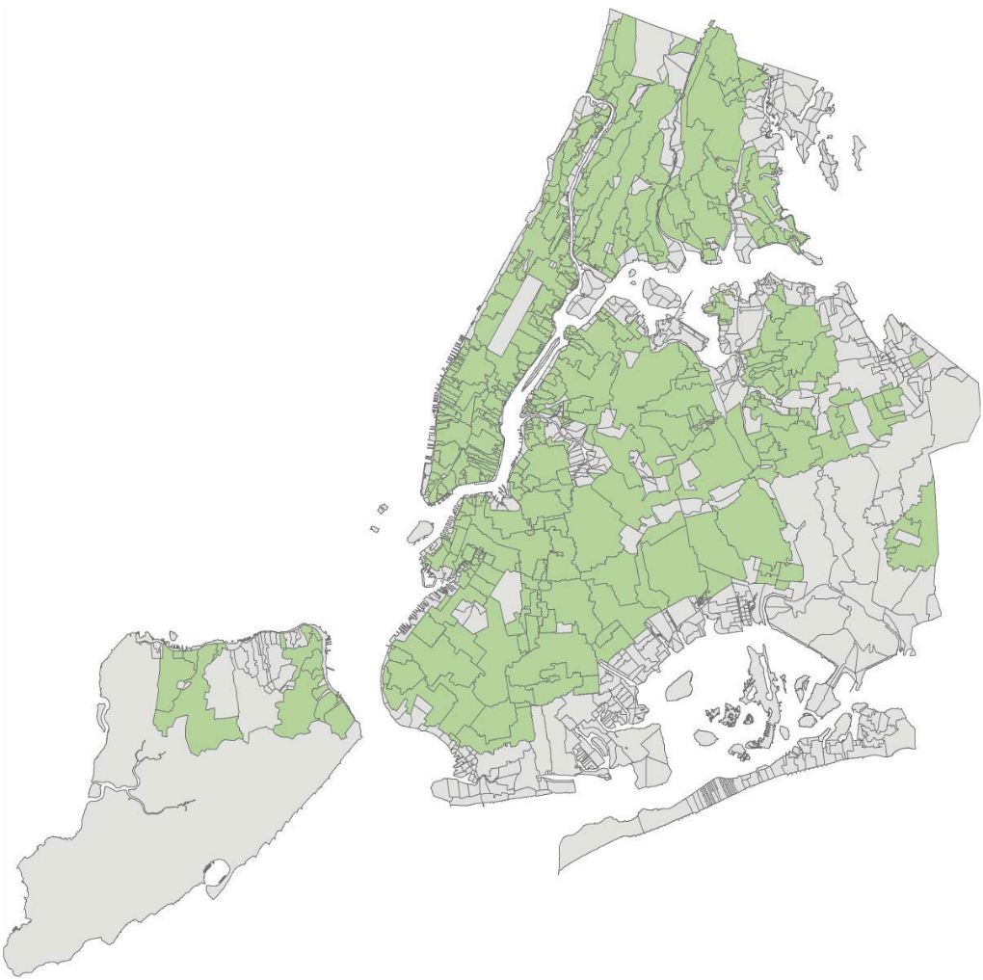
NYC Sewer System
7,400 total miles of sewers
3,337 miles of combined sewer
2/3 of area of city served by combined sewers
14 Wastewater Treatment Plants
Over 430 CSO outfalls
Notes:
Green – areas served by combined sewers. Most (2/3) of the area of NYC is served by CS.

Slide 5
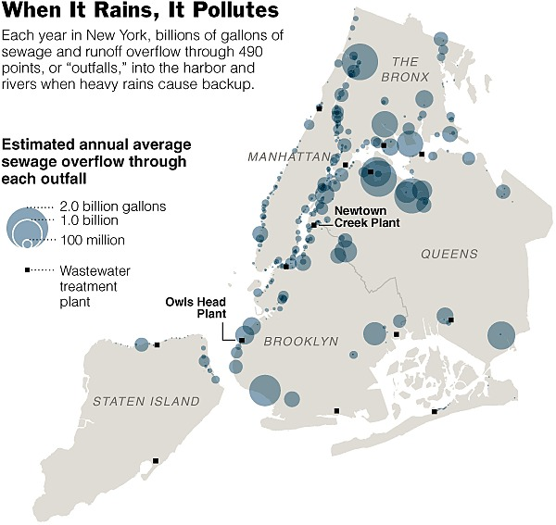
CSO Spills

Slide 6
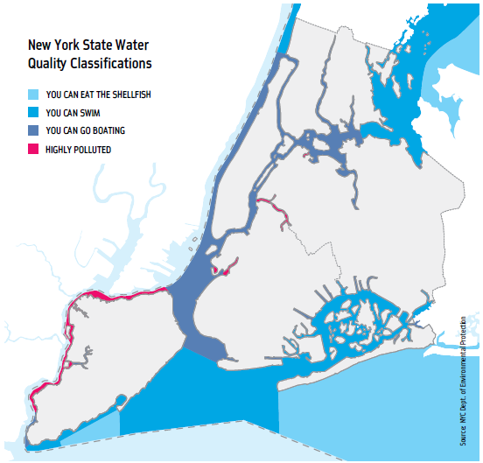
Water Quality in New York City Harbour
75% of Harbor meets pathogen standards for swimming
19% meets standards for boating and fishing
7% of our Harbor is made up of tributaries that do not meet secondary standards
Notes:
WQ better than it has been in over 100 years of testing.
$10B spent in last 10 yrs. (new WWTPs, upgrades, etc.)
We meet WQ in most of harbor.
Red is where we don’t currently meet WQ.
WQ as per US EPA criteria.

Slide 7
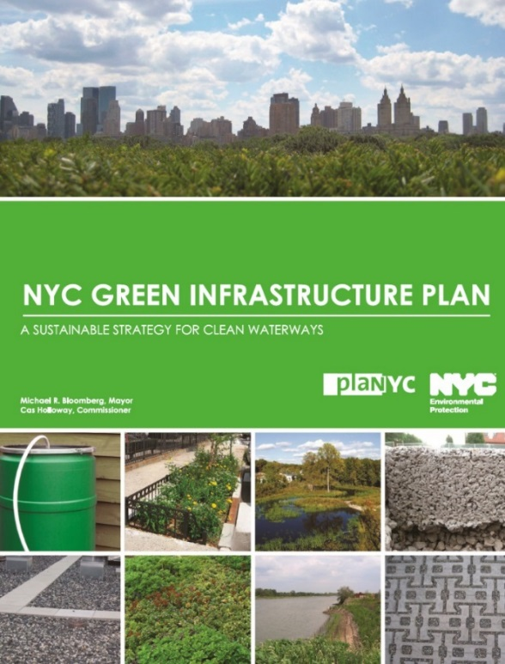
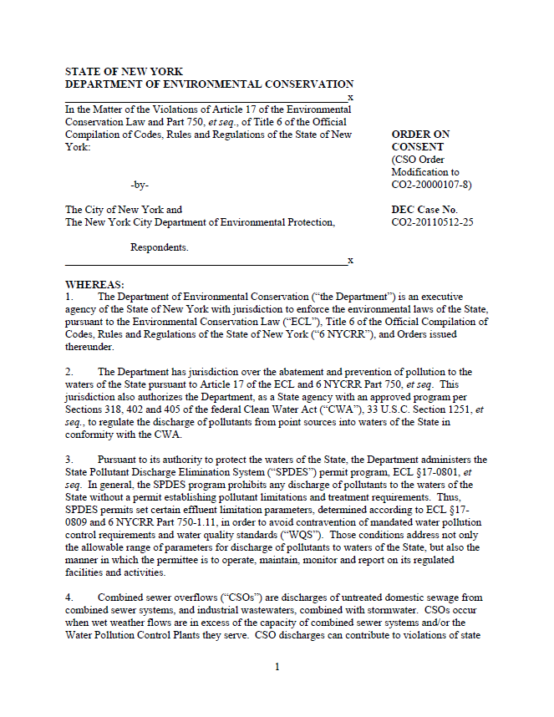
NYC DEP Green Infrastructure Program
2010 – NYC Green Infrastructure Plan
Laid framework to use green infrastructure to manage 1” of stormwater runoff from 10% of impervious surfaces in combined sewer areas by 2030.
2011 – DEP Office of Green Infrastructure (OGI)
Created to implement GI Plan and coordinate NYC agencies
2012 – Amended Consent Order
DEP and NYS Department of Environmental Conservation (DEC) signed a historic agreement to incorporate a green and grey adaptive management approach into the CSO program.
Green Infrastructure Program Timeline
Notes:
OGI created in 2011; work with city agency partners (DOT, DPR, EDC, DDC, MTA)
Consent Order not green only. : hybrid grey/green approach.

Slide 8
NYC DEP Green Infrastructure Program
Manage 1” of stormwater runoff from 10% of impervious surfaces in combined sewer areas by 2030
DEP has committed to invest $1.5 billion in green infrastructure through 2030.
GI Application Rates and Consent Order Milestone Schedule
Notes:
1” because 90% of our storms are 1.0” or less and 70% are 0.5’ or less - so we’re managing a vast majority of our storms. Green infrastructure works every time it rains. Grey may only be used a few times per year. VOLUME-BASED
Deember 31, 2015 yielded 0.6% citywide, had 437 impervious acres managed and requires 744 more impervious acres to meet 1.5% (as part of contingency plan)

Slide 9
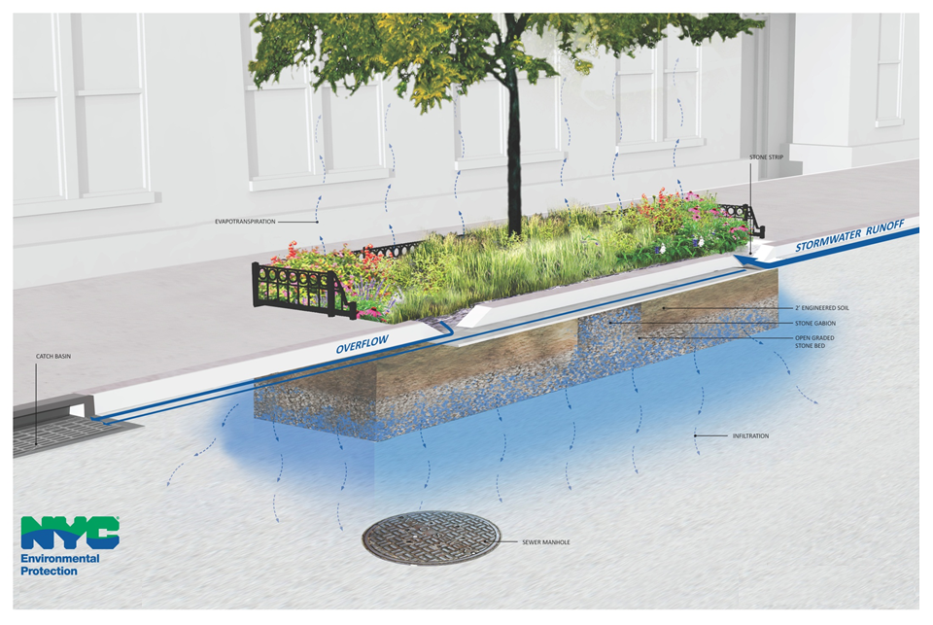
Right of Way Bioswales
Right-of-Way Bioswale
Notes:
NYC have initially implemented a standardized approach to GI implementing right of way bioswales between 10-20 feet long and stormwater green streets in bump outs.

Slide 10
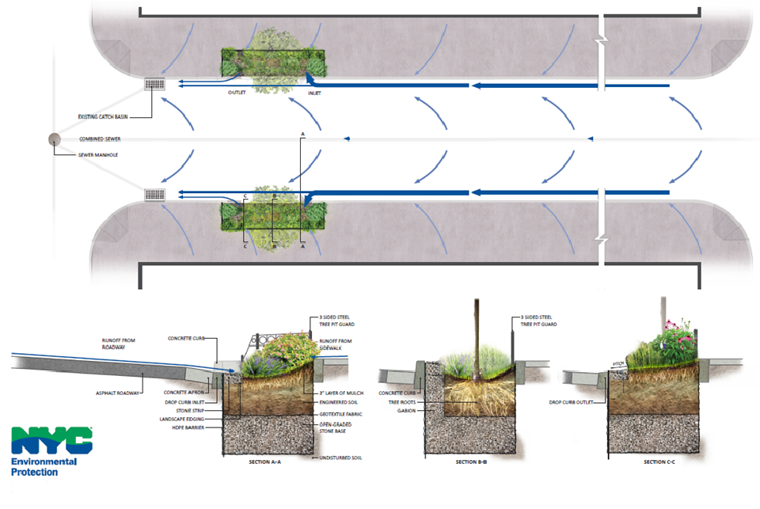
Right-of-Way Bioswale (ROWB)

Slide 11
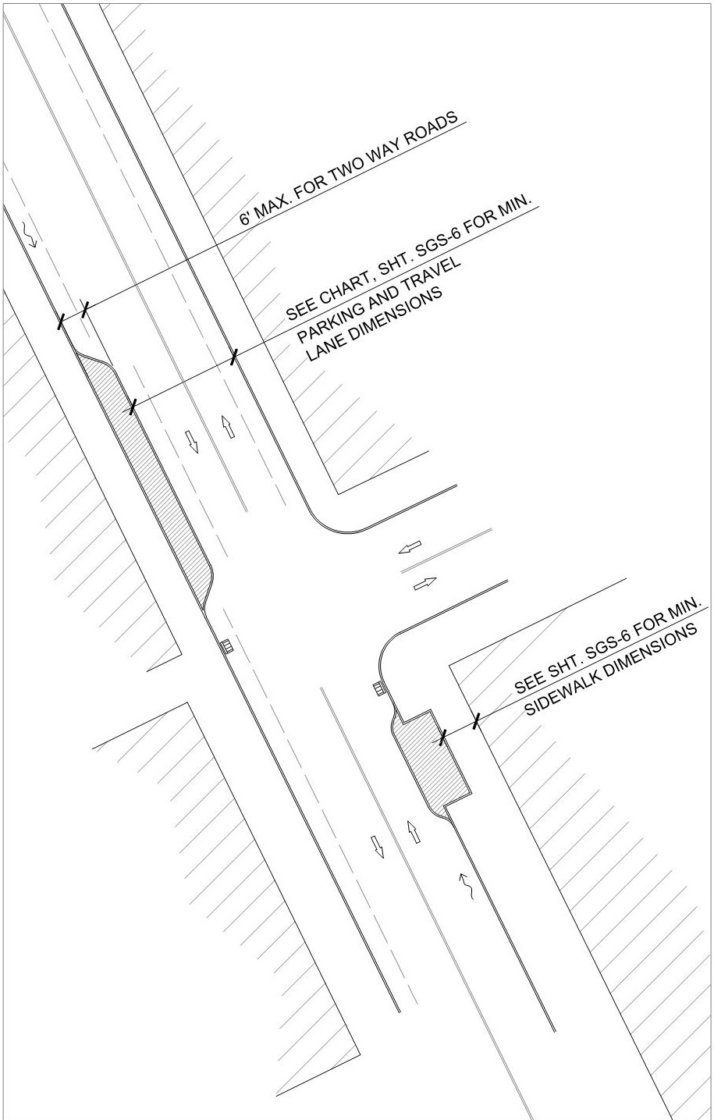
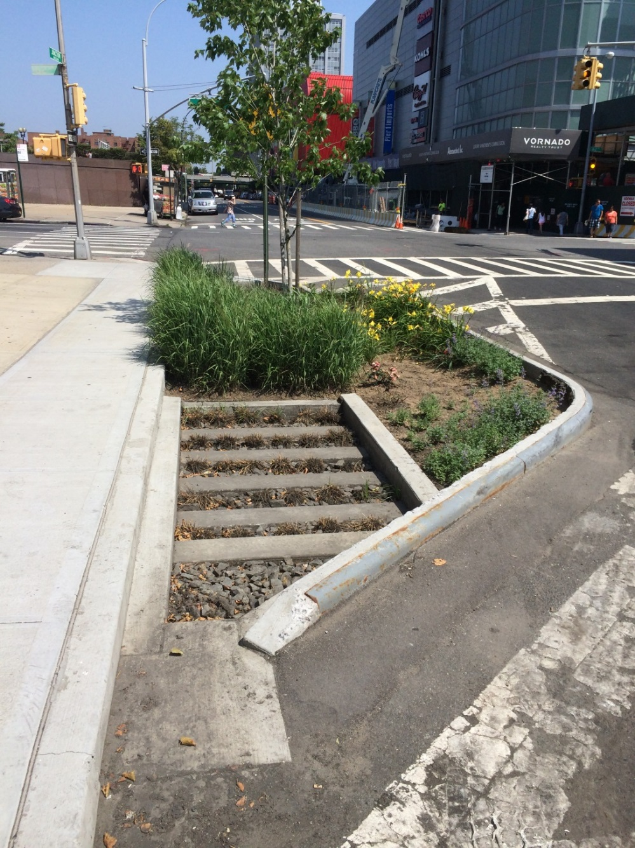
Stormwater Greenstreet (SGS)

Slide 12
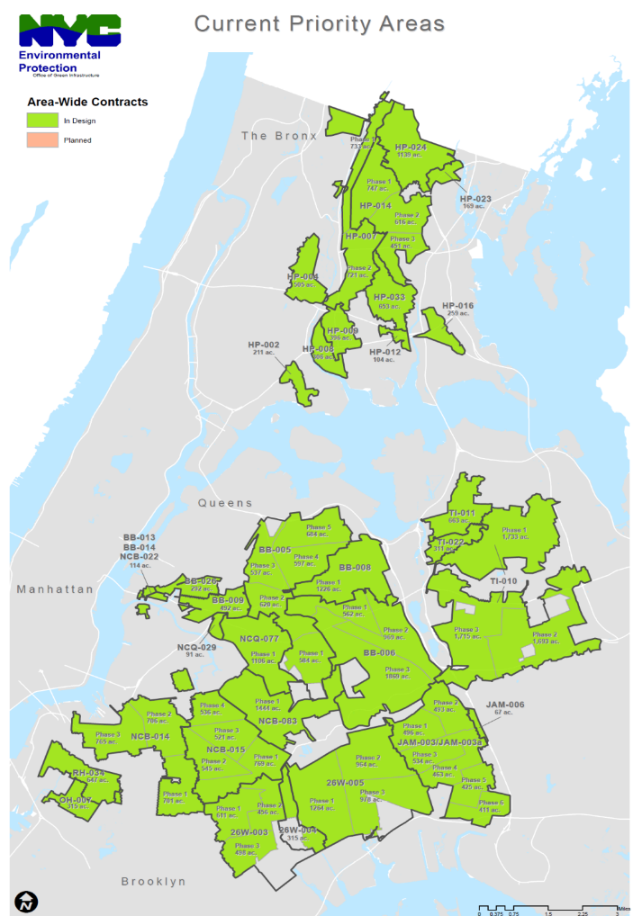
NYC DEP Green Infrastructure Program
The Area-wide Approach allows OGI to:
Focus resources on selected CSO tributary areas (Priority Areas)
Saturate these CSO tributary areas with as much GI as practical
Achieve efficiencies through standard designs, specifications and procedures
The Area-wide Approach allows OGI to:
Focus resources on selected CSO tributary areas (Priority Areas)
Area-wide Approach
Notes:
Importance of standardizing procedures for large scale roll-out; A design consultant is assigned to each area.
Priority CSO Areas have been selected based on:
combined sewer outfall volume,
frequency, and
receiving water body quality

Slide 13
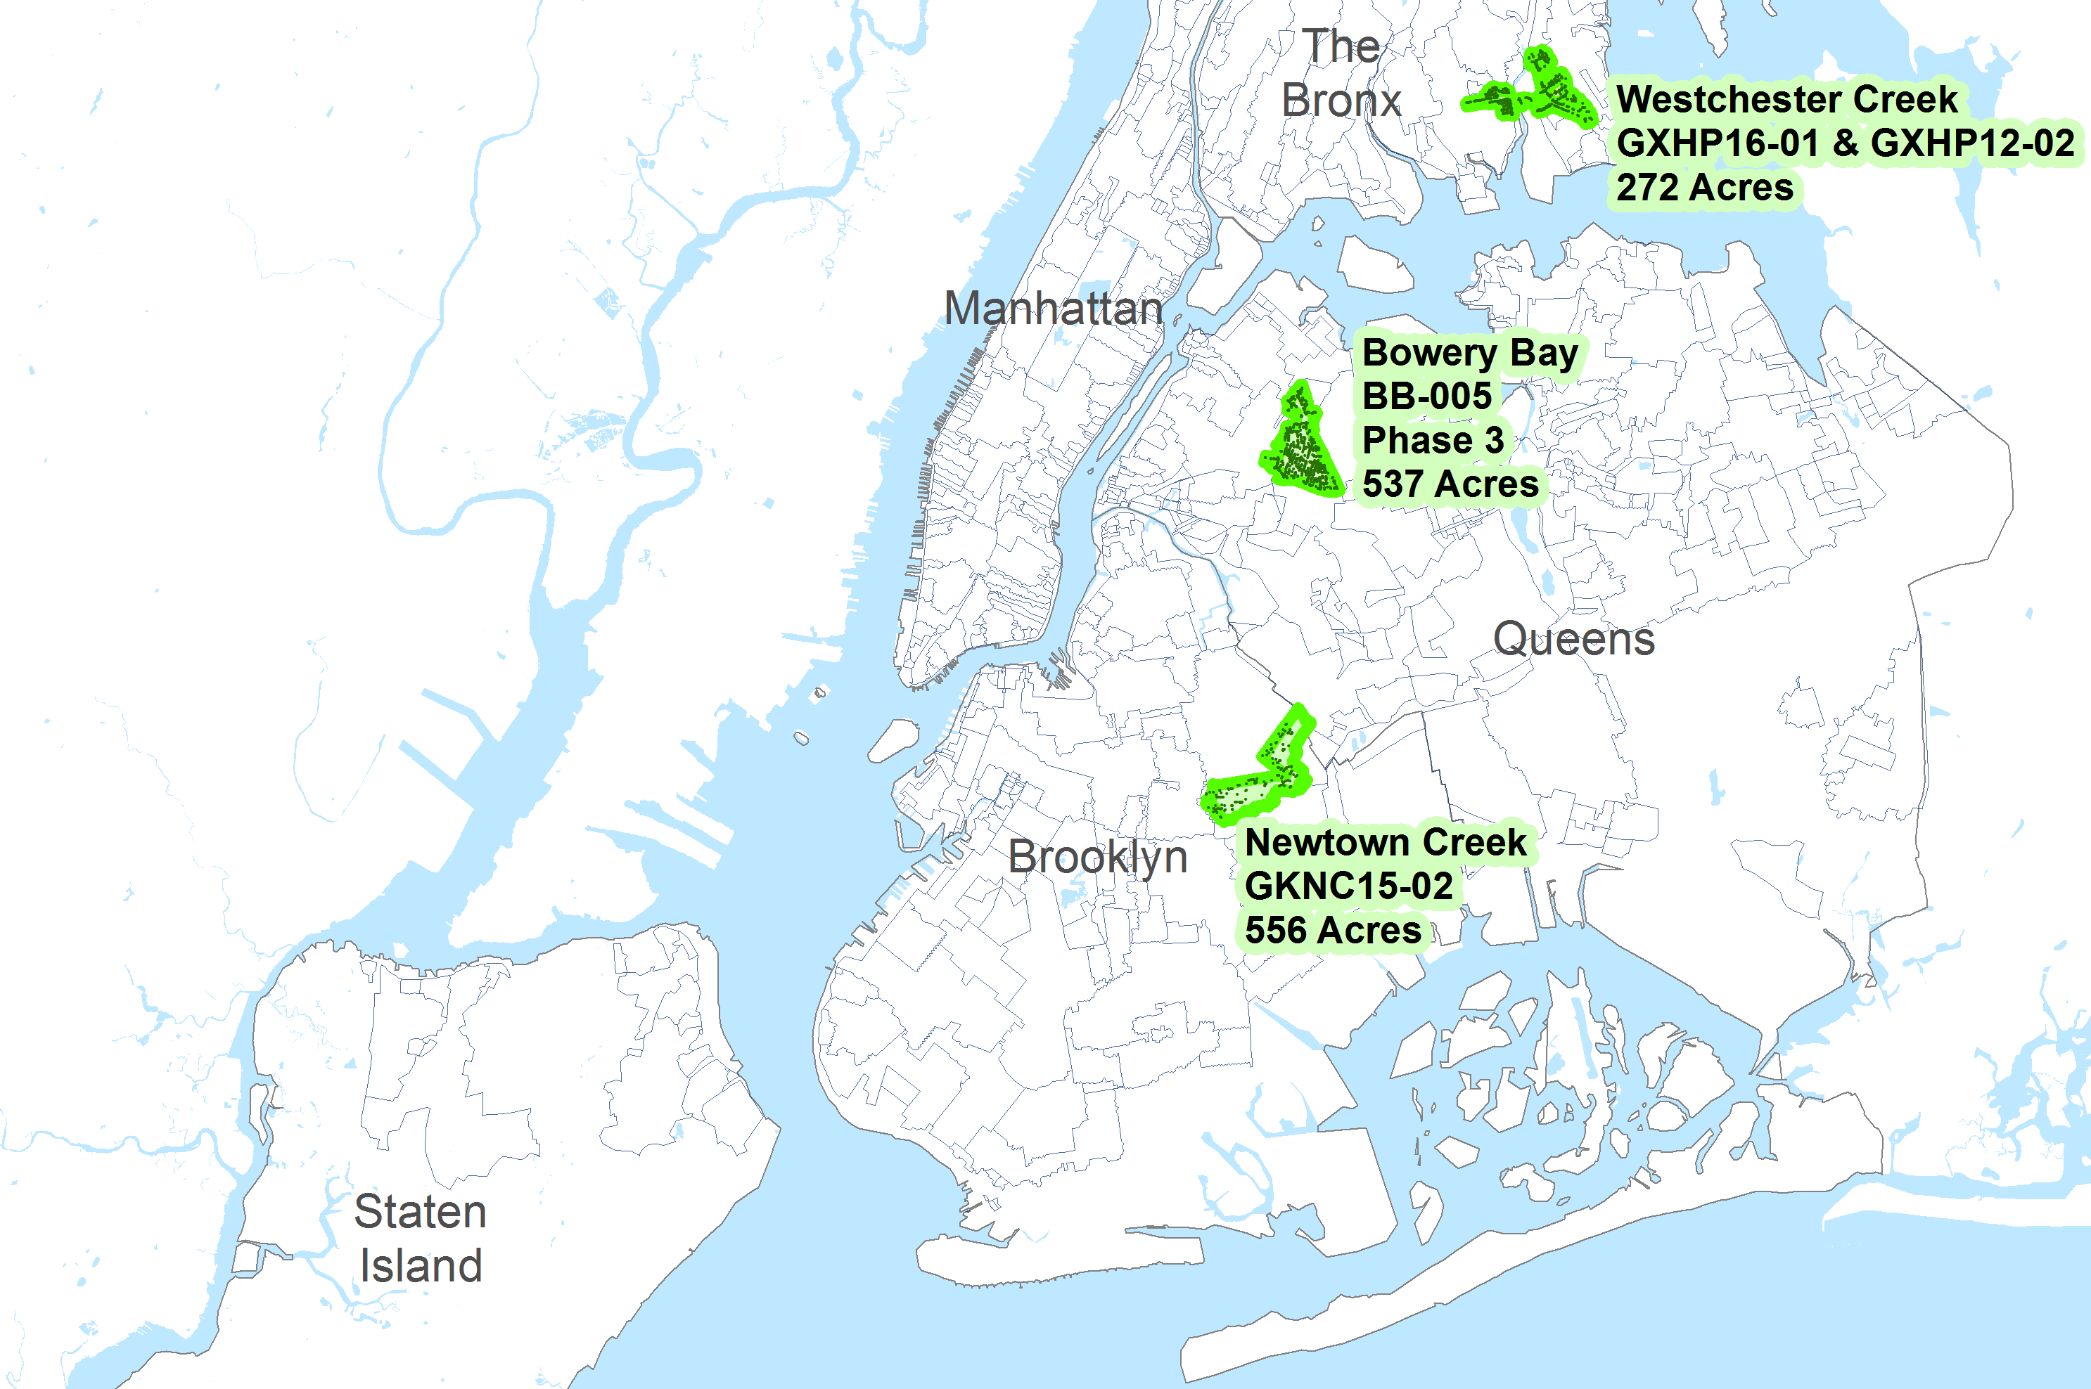
Arup Contracts
Notes:
Arup have three contract areas. I will talk through the process we used from Newtown Creek one of the biggest areas.

Slide 14
Design Process and Design Outcomes
Area-wide Design Procedure
Hydraulic Analysis
Site Walkthroughs
Geotechnical Investigations and Topographic Survey
Design and Construction
Notes:
A key component of this project is the management of data between all of these phases.
Hydraulic Analysis: Arup completed hydraulic analyses for the entire right-of-way in the NCB-015 in Brooklyn, New York. DEP aims to install green infrastructure to manage 100% of the runoff volume of a 1” storm event. Going above the 10% goal because of site limitations in other areas
Site walkthrough: Identified locations for green infrastructure based on hydraulic analysis and DEP, DOT, and DPR requirements. Arup visited over 1400 potential locations in our contract area – 96 miles.
Geotech & Survey: Completed soil boings and permeability tests for all compliant locations identified during site walkthroughs. An average of 1.5 tests per day
DEP OGI evaluated sites based on USCS soil classifications, sieve analysis results, and calculated permeability coefficients. Recommended for topo survey if satisfactory.
Design: DEP OGI has GI design standards and guidelines set out for ROWBs & SGSs design, streamlining the design process.
Construction: DEP issues construction packages of 200 or more ROWBs/SGSs at a time.

Slide 15
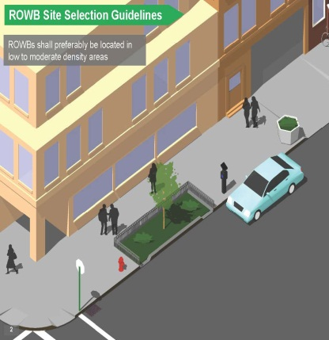
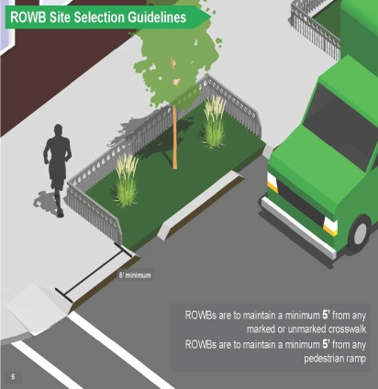
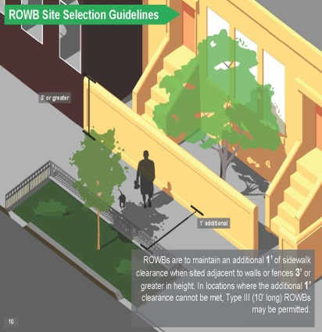
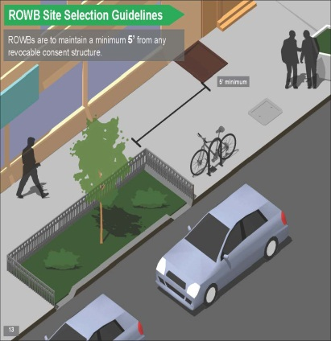
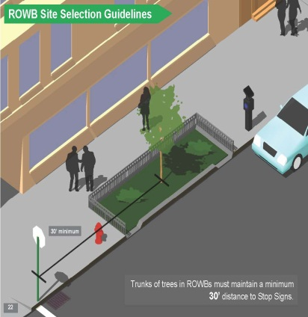
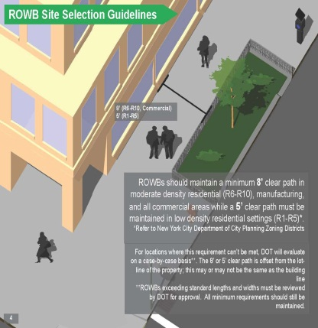
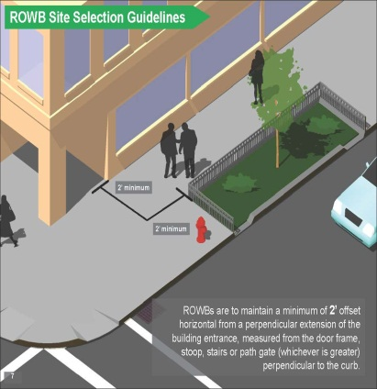
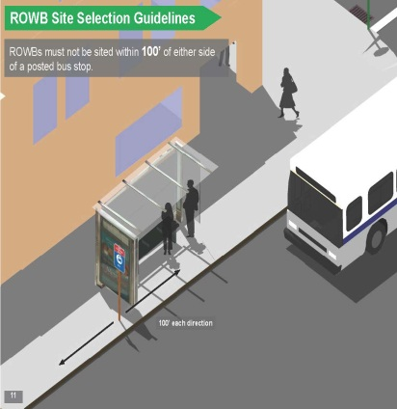
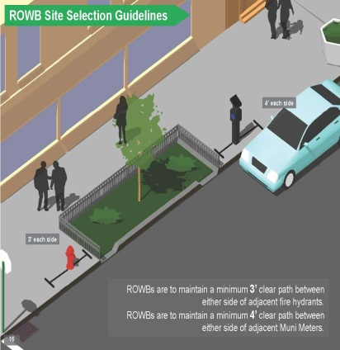
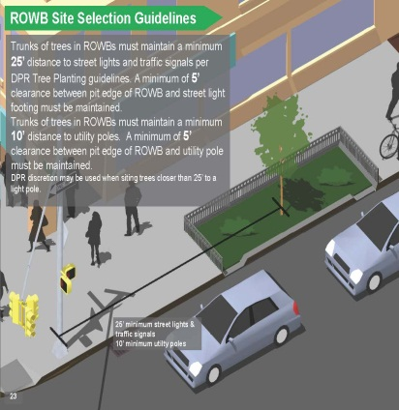
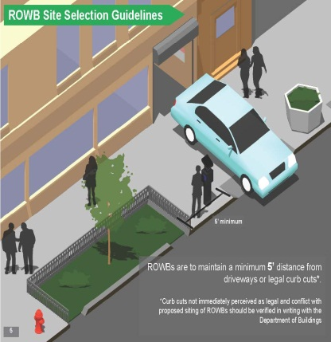
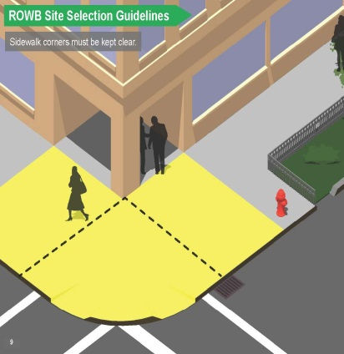
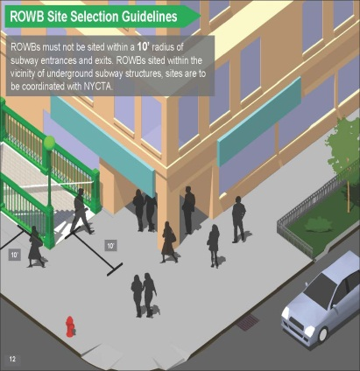
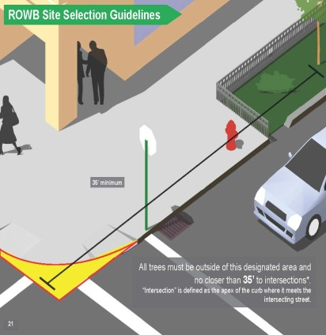
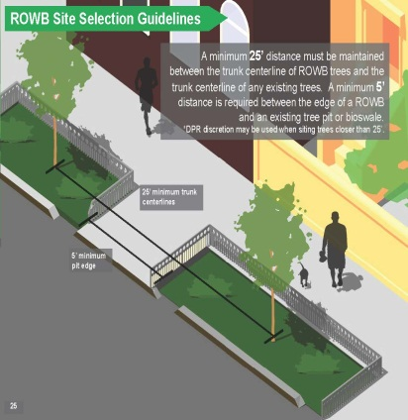
NYCDOT Siting Guidelines
Notes:
In order to locate the green infrastructure on site, NYCDOT have set out some siting guidelines.
Key Criteria:
• Sidewalk clear path requirements based on pedestrian density
• Offsets from curb cuts, driveways, building entrances, street furniture, etc.
• Clearance from underground vaults, basements, and chambers
• Clearance requirements from DEP infrastructure
• Acceptable construction zones near mature trees
• Tree spacing and offsets for line-of-sight requirements

Slide 16
Design Outcomes
Hydraulic Analysis
Contract Target: 578 ROWBs
704 Potential ROWBs
Site Walkthroughs
655 Preliminary ROWBs
Geotech. & Survey
197 ROWBs
Design & Construction
143 ROWBs
Notes:
Original target was 578 bioswales through site walkovers and geotech and survey this has reduced to 197 bioswales. Deember 31, 2015 yielded 0.6% citywide, had 437 impervious acres managed and requires 744 more impervious acres to meet 1.5% (as part of contingency plan)
This becomes a lot of data once we run through each phase individually…

Slide 17
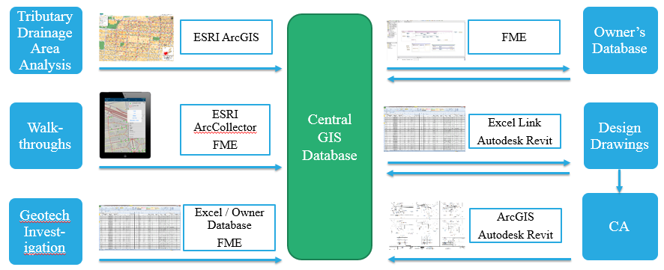
Data Integration

Slide 18
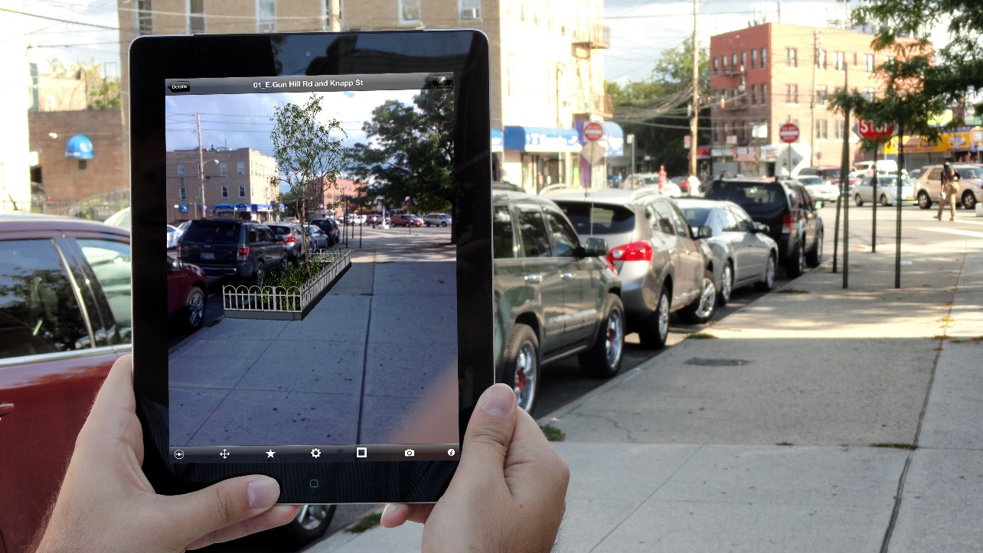
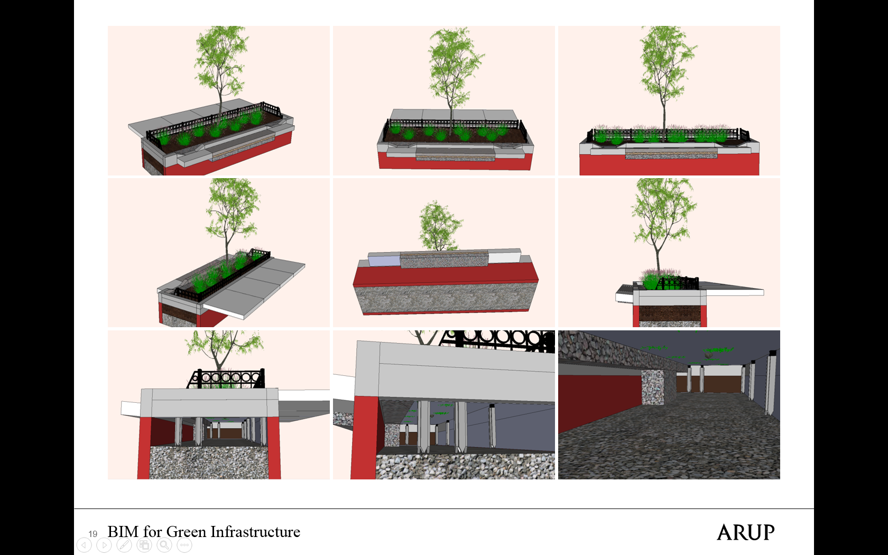
Augmented Reality
Notes:
While not a client requirement, we have also explored the use of augmented reality as a community outreach tool and 3D modeling to link specifications and inform on any potential constructability issues.
Our automated project delivery allows us to consider other platorms and think about how we can improve the collection and visualization of data.

Slide 19
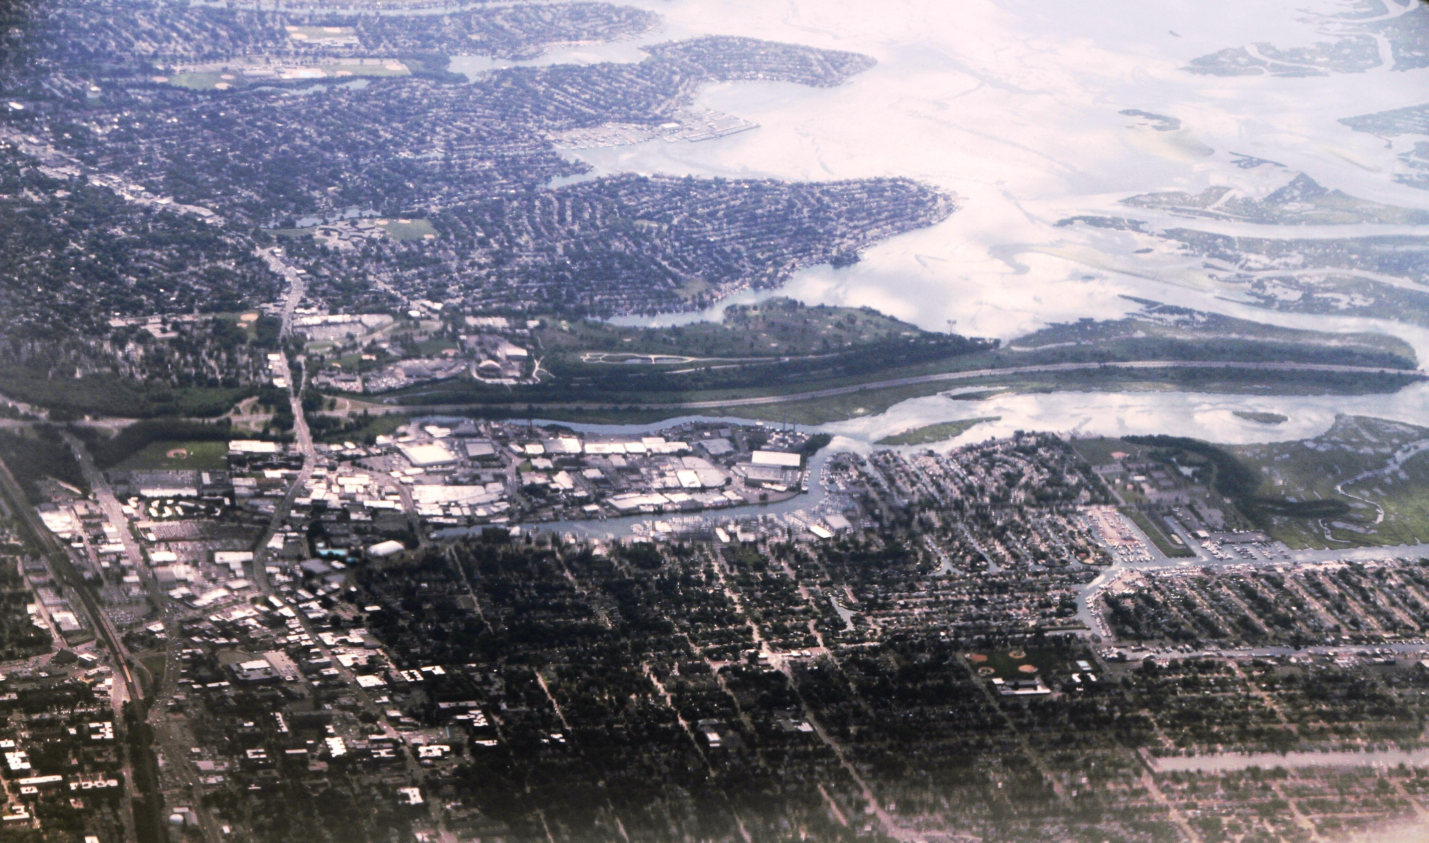
NY Rising Program
95,534 homes destroyed or damaged
10% of homes experienced flooding
More than 1 million homes were without power
8,000 jobs lost in the 2 months following Sandy
Bay Park WWTP lost power for 50 hours
Notes:
Superstorm Sandy was a game changer for many in the area and really catapulted “resilience” into the conversation of political leaders, planners, business and home owners.
Bay Park resulted in 200 million gallons of sewage flowing in waterways
The South Shore of Long Island, like many other shore areas, suffered massive storm surge damage, power outages, sewer line overflows and utility and transportation disruption.

Slide 20
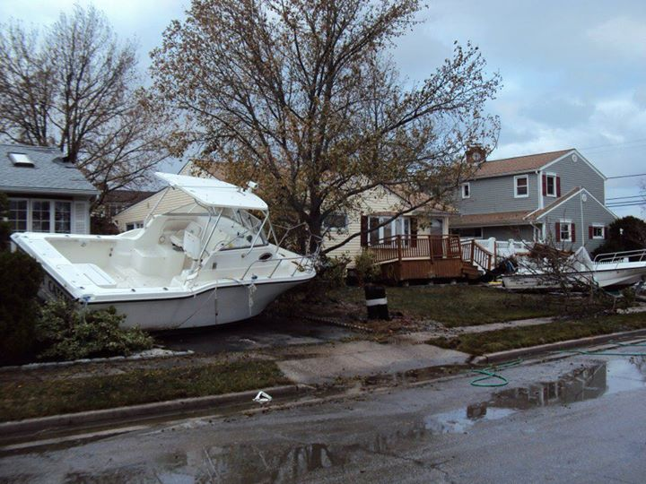
Notes:
The South Shore of Long Island, like many other shore areas, suffered massive storm surge damage, power outages, sewer line overflows and utility and transportation disruption. Flooding from Sandy exceeded many of the FEMA 100-year flood zones and directly or indirectly, the lives and well-being of virtually everyone in the region were, and continue to be, affected by the storm’s aftermath.

Slide 21
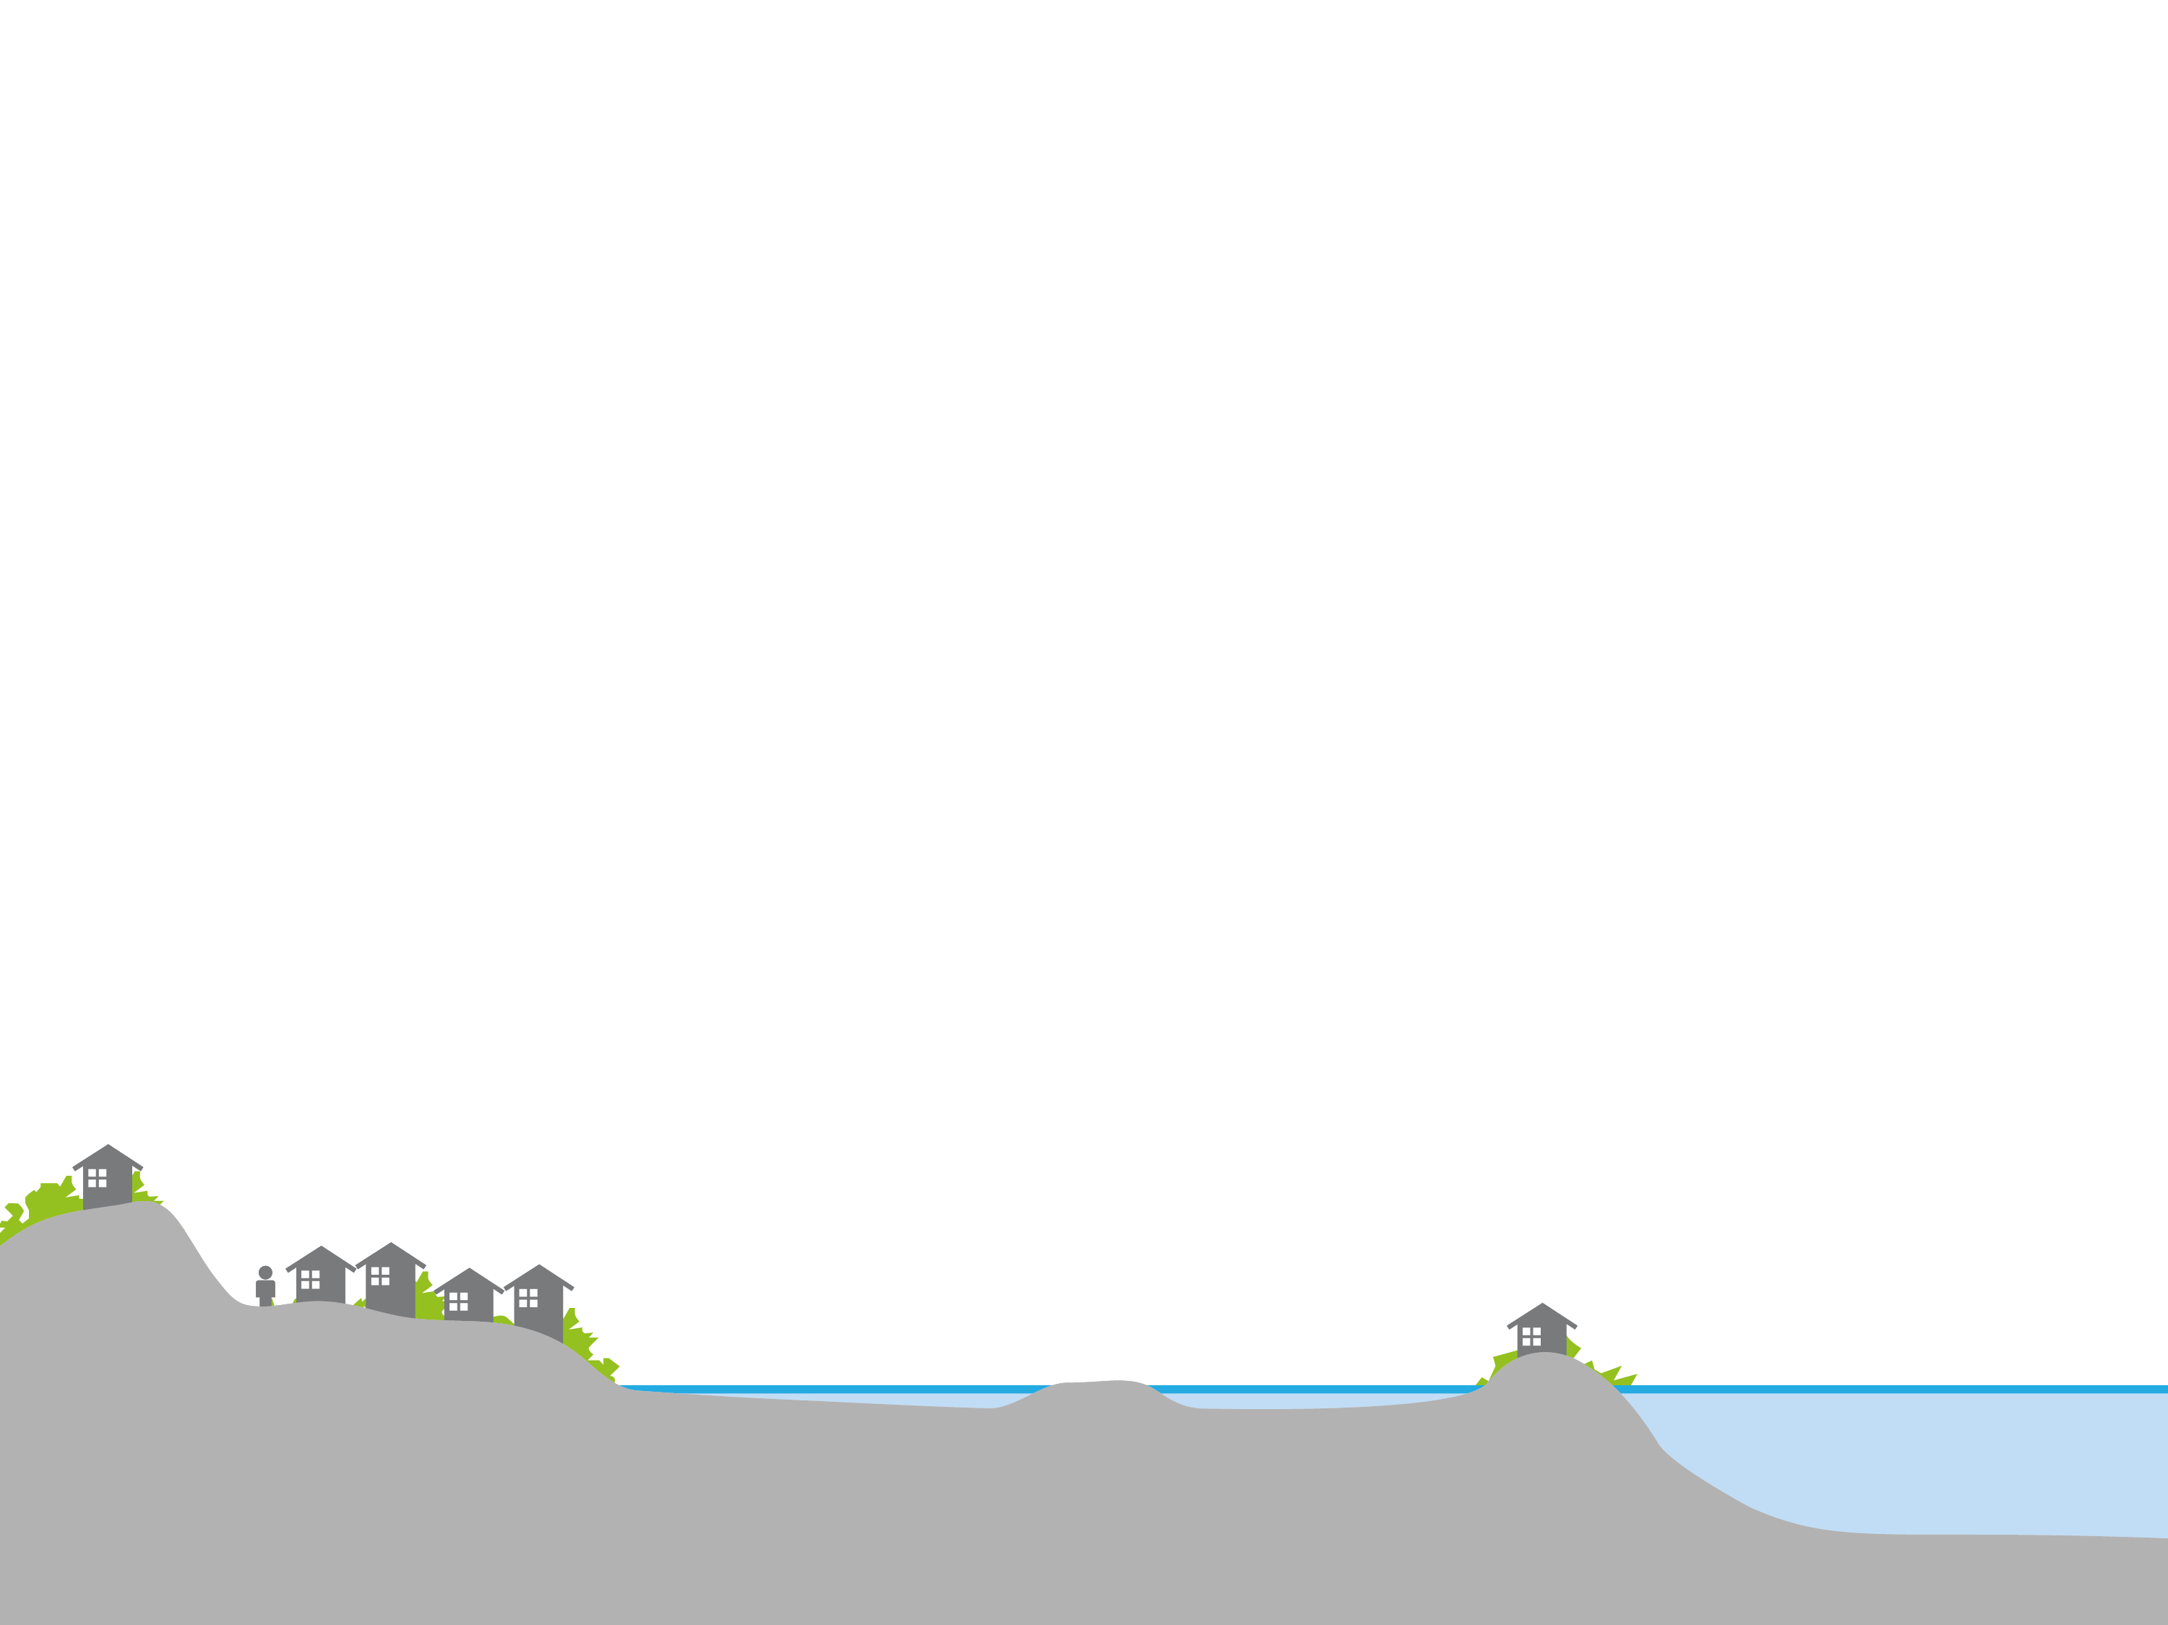
Approaches
HARD INFRASTRUCTURE
GREEN
INFRASTRUCTURE
NATURAL SYSTEMS
Notes:
Hard infrastructure eg new bulk heads and flood defences
Natural systems with sandscaping and artificial reefs being discussed.
Green infrastructure to improve drainage for 90% of the storms in the rebuild.

Slide 22
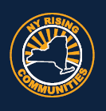
Building Back Better
NY Rising Program
NY State established the New York Rising Community Reconstruction Program (45 in total)
Funded through US Department of Housing and Urban Development (HUD) Community Development Block Grant – Disaster Recovery (CDBG-DR)
Up to $25 million allocated for reconstruction planning in the most affected communities ($650 million allocated for all communities)
NY Rising Program
Notes:
$25 million of funding from the US Department of Housing and Urban Development Community Development Block Grants for Disaster Recovery, were allocated for reconstruction planning in the most affected communities. The program enabled communities to identify resilient and innovative reconstruction projects and other needed actions based on community-driven plans that consider current damage, future threats and the communities economic opportunities. Each NY Rising Community had a Planning Committee comprised of community residents and stakeholders working closely with a Consultant Team and State planners to help develop a recovery plan that will be eligible to receive funds to support the implementation of those identified projects and activities.

Slide 23
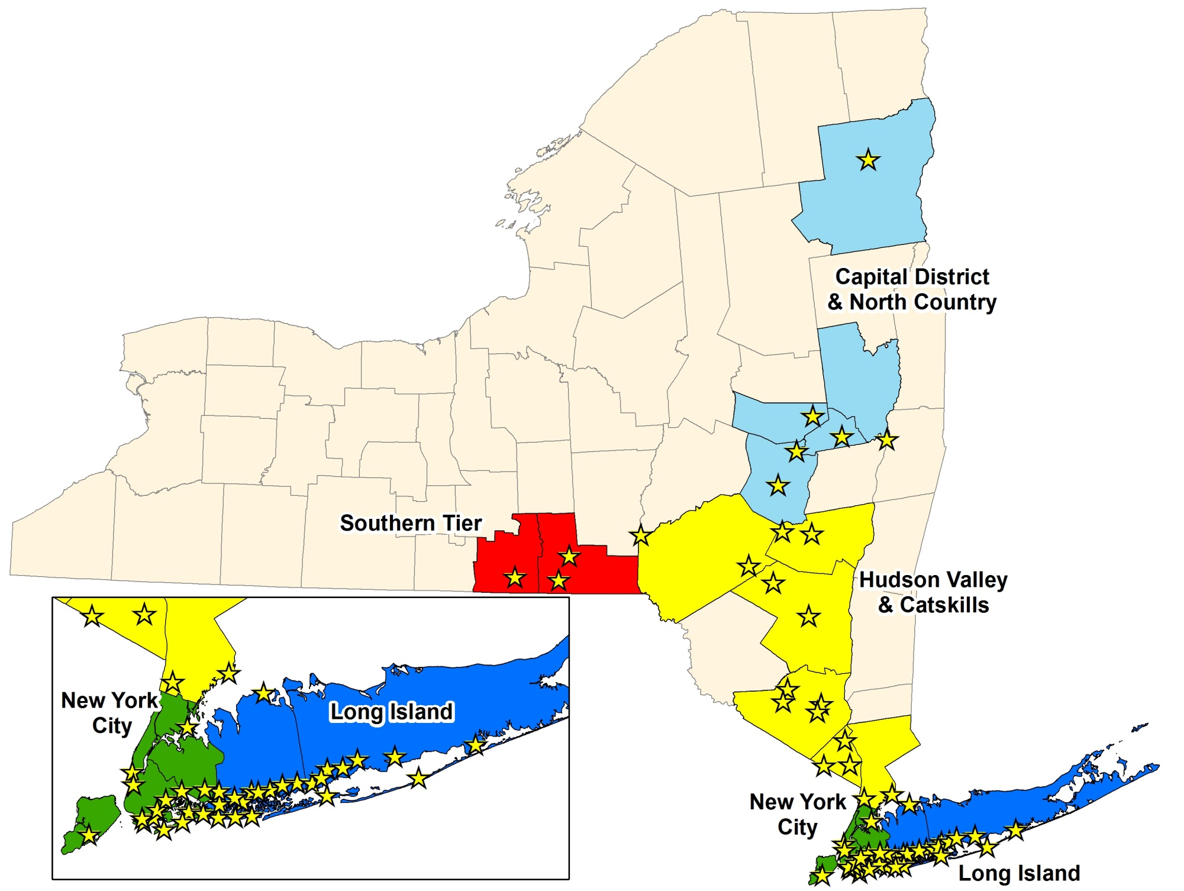
NY Rising Program
Notes:
The communities chosen, as shown here on this map, are not only communities that were affected by Superstorm Sandy, but also upstate communities that are still recovering from the damage from Hurricane Irene and Tropical Storm Lee the year before Sandy.

Slide 24
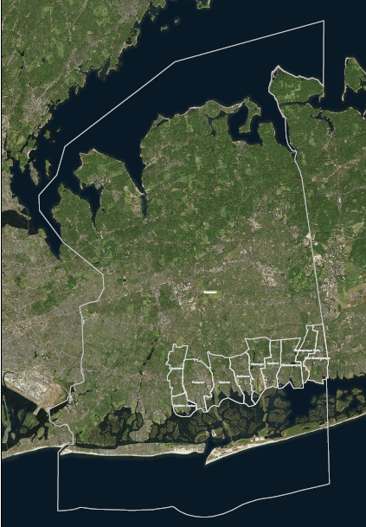
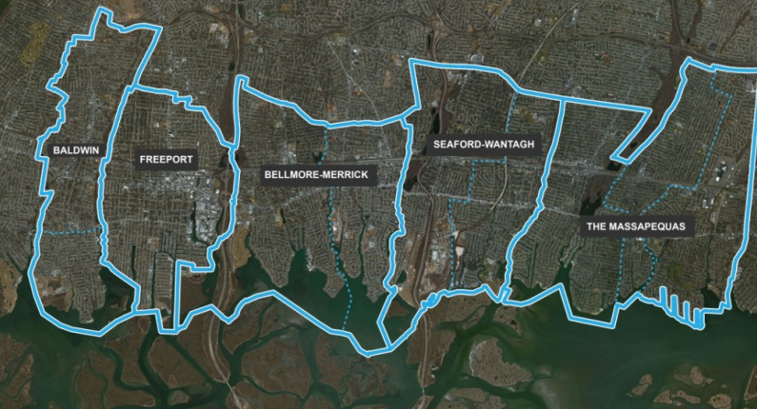
5 Communities:
Baldwin
Freeport
Bellmore / Merrick
Seaford / Wantagh
Massapequas
~35 square miles
209,000 residents
6 Watersheds
NY Rising Program
Notes:
Arup worked with 5 communities on the South Shore of Long Island, which covers about 35 square miles and a population of about 209,000 residents, located within 6 different watersheds.
2 Villages – Village of Freeport, Village of Massapequa Park
8 Hamlets – Baldwin, Baldwin Harbor, Merrick, Bellmore, Wantagh, Seaford, Massapequa, and East Massapequa
2 Towns – Town of Hempstead (inc Baldwin, Baldwin Harbor, Merrick, Bellmore, Wantagh, Seaford) and the Town of Oyster Bay (Massapequa and East Massapequa)
The aim was to produce recovery strategies for the communities, which built back better. One component of these recovery strategies was GI.

Slide 25
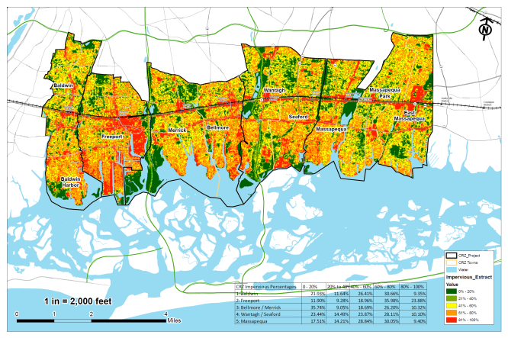
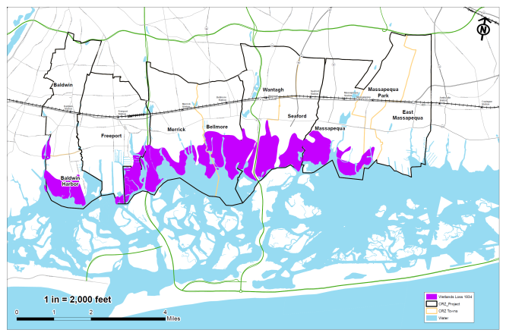
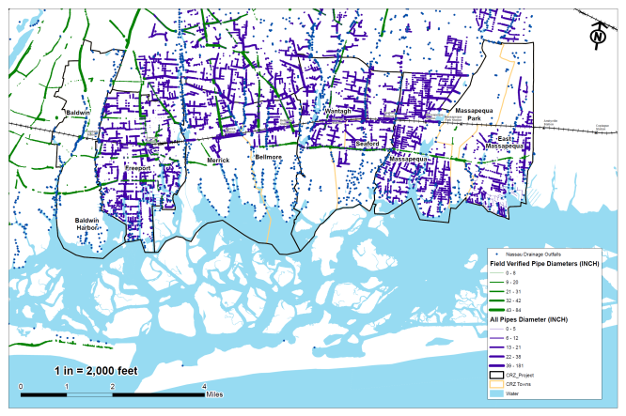
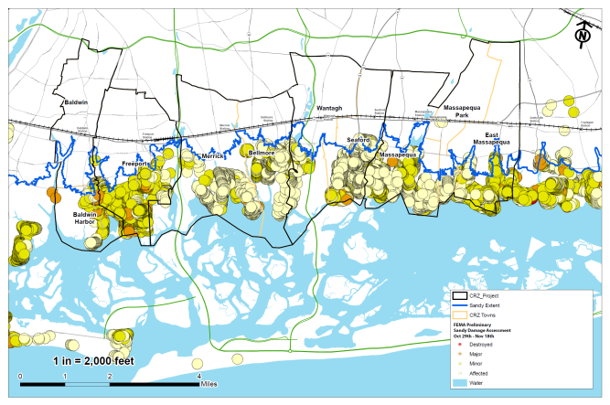
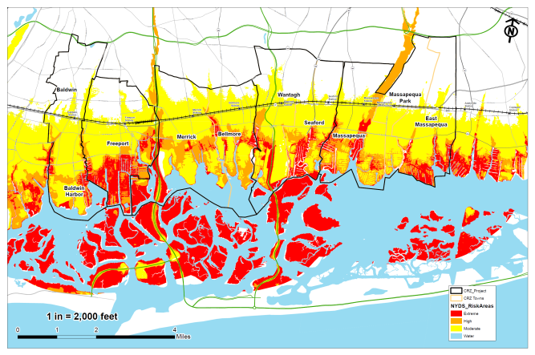
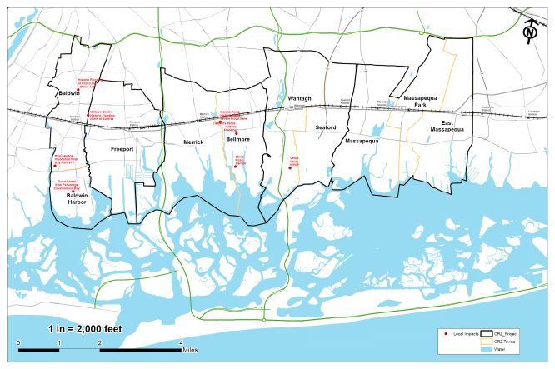
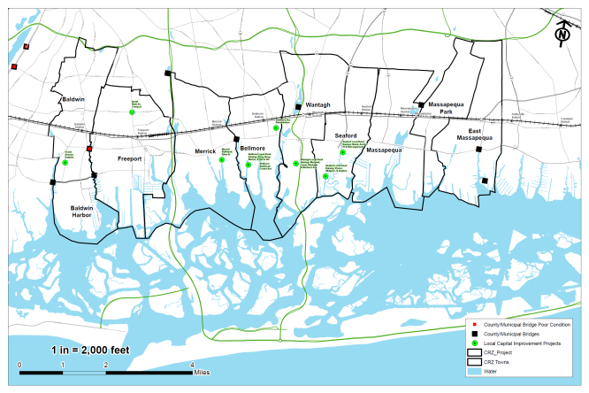
How do we identify tangible and implementable projects in a 35 square mile area that can serve as pilot projects for the most affected communities?

Slide 26
Planning Process
Opportunity Mapping
Pilot Projects
Prioritization
Notes:
While developing projects and actions for inclusion into the Plan, Planning Committees took into account cost estimates, cost-benefit analyses, the effectiveness of each project in reducing risk to populations and critical assets, feasibility, and community support. Planning Committees also considered the potential likelihood that a project or action would be eligible for funding.

Slide 27
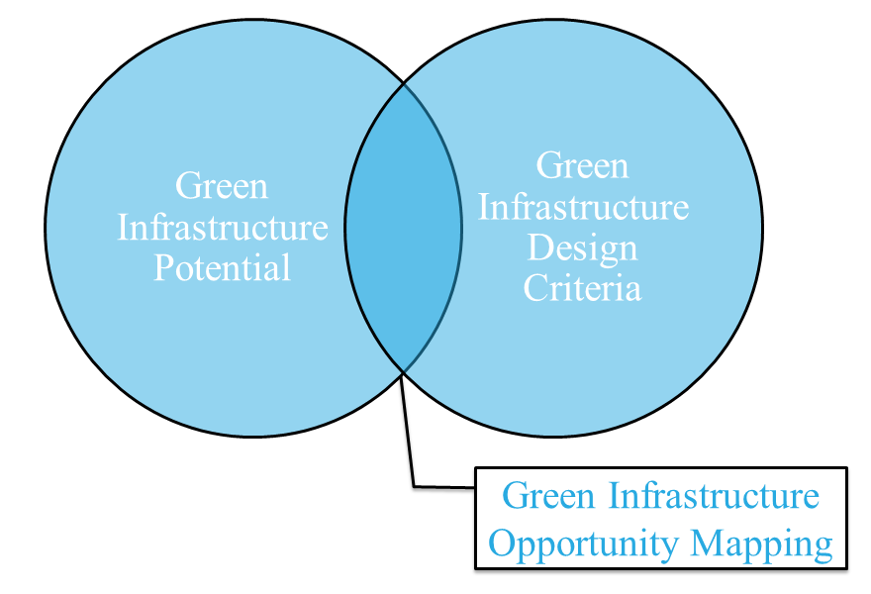
Notes:
To develop a framework plan for this area, GIS was utilized to develop a green infrastructure map that is created from the intersection of existing condition mapping and green infrastructure design criteria. Python scripts were used to streamline the process.

Slide 28
Potential Opportunities
Green Infrastructure Potential
Land Use and Parcel Areas
Existing Topography
Wellhead Protection Areas
Steep Slopes
Soil Types
Groundwater Depth
Natural Resource Protection
Notes:
In a similar manner as a land use zoning map, the green infrastructure framework plan essentially provides a menu of green infrastructure strategies for each parcel based on the following existing condition criteria

Slide 29
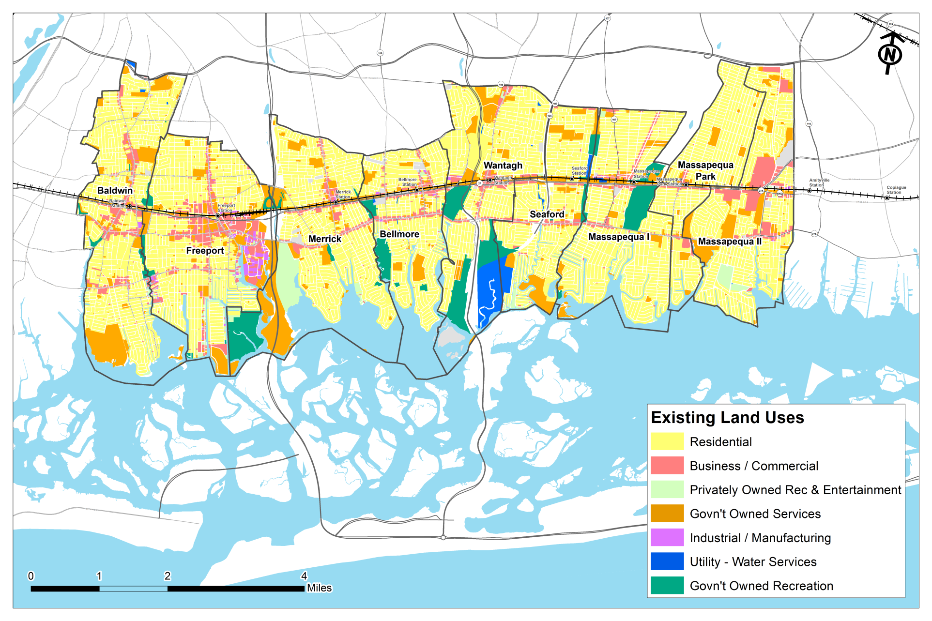
Existing Land Use

Slide 30
Existing Topography

Slide 31
Aquifers and Wells

Slide 32
Steep Slope Analysis

Slide 33
NRCS Soils Map

Slide 34
Groundwater Map

Slide 35
Natural Resources

Slide 36
Identifying Opportunities
Green Infrastructure
Opportunities
Natural Resources
Groundwater
NRCS Soils
Steep Slope Analysis
Aquifers and Wells
Existing Topography
Land Use and Parcels
Notes:
The New York State Department of Environmental Conservation categorizes stormwater management into 5 categories: Ponds, Wetlands, Infiltration Systems, Filtration Systems, and Open Channels. Each of these practices are defined by site-specific design criteria that can be used to inform the framework plan including those I just showed. The acceptable criteria were cross-checked with the existing site conditions to develop the opportunity mapping.

Slide 37
Combined Opportunities Zones
Notes:
And here is the result of this analysis. This mapping exercise is merely identified green infrastructure opportunities at a macro-scale based on existing site conditions from available open data.

Slide 38
Priority Areas
Green Infrastructure Prioritization
High Impervious Coverage
Public or Vacant Land
Existing Drainage Capacity Issues
Watershed Pollutants
Historic Wetland Loss
Locally Identified High Impact Areas
NYS Risk Map
Notes:
The next step in the analytical process was to identify the priority areas for potential pilot projects as part of the NY Rising Community Reconstruction program. The following criteria used to determine the target areas for pilot projects including GIS data and mapping for

Slide 39
Combined Prioritization Map

Slide 40
Intersecting Priority and Opportunity

Slide 41
Green Infrastructure Pilots
4 green infrastructure pilot projects of various scales to address severe flooding and ‘every-day’ rainfall events
Project Identification
Notes:
Identified 5 projects

Slide 42
Downtown Corridor in Merrick and Bellmore
Green Infrastructure Pilots
A comprehensive planning and resiliency study to re-envision the downtown and commercial corridors including GI opportunities
Project Identification
Notes:
This project includes a comprehensive planning and resiliency study to re-envision the downtown and commercial corridors in both Merrick and Bellmore. The planning study will address the following:
Opportunities for housing and commercial business creation

Slide 45
Hunters Point South, New York
Notes:
30 acres
5000 housing units (60% affordable) in 7 parcels
New school
11 acre waterfront park and a neighborhood park.
Roadways, sewers and utilities for the development.

Slide 46
Notes:
Phase 1 has more formal programming as it is adjacent to the school.
-Astroturf oval for school exercise and community exercise, e.g. community Zumba and yoga classes. There are also events held there, most recently a silent disco and outdoor movie screening and July 4th fireworks.
-Concession building with coffee shop, deck area and shade canopy.
- Park maintenance and operation building
-Beach area
-Children’s play area and half court basket ball
-Dog run
-Rail garden which incorporates the industrial elements of HPS past
-Running along center blvd, there is the bioswale which ties the whole park together and segregated bicycle park.

Slide 47
Notes:
Habitat creation is also a major focus for phase 2 with 0.94 acres of wetland mitigation. In addition, phase 2 includes a boat launch and adult exercise terrace and the neighborhood or linear park, which includes an additional childrens play area.

Slide 48
Green Infrastructure
Notes:
As I mentioned previously, the green infrastructure that has been incorporated into the site is integral to the site’s resiliency. There are three main types of green infrastructure. Firstly, on 51st Ave, we piloted stormwater planters. These were the precursors to the NYC DEP bioswales and extensive collaboration was required between NYC DOT, DEP and DPR. Secondly, the backbone of the park is a large bioswale which attenuates and treats the majority of the stormwater runoff from the park and the bicycle lane. Finally, a portion of the stormwater runoff from the streets is treated by tree planters with porous concrete strips.

Slide 50
Porous Pavement

Slide 51
Notes:
In total, 0.94 acres of wetland mitigation are being provided. This wetland mitigation will be high value with a mixture of low marsh, high marsh and salt shrub and with tidal channels and tidal pools. There is a revetment structure around the wetlands with a pedestrian path and culverts through the revetment to link the wetland to the East River.

Slide 53
Any Questions?

